Slide 1
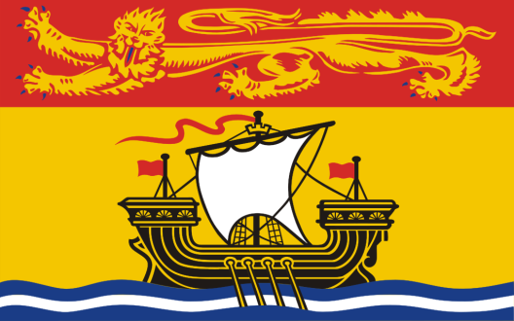
New Brunswick

Slide 2
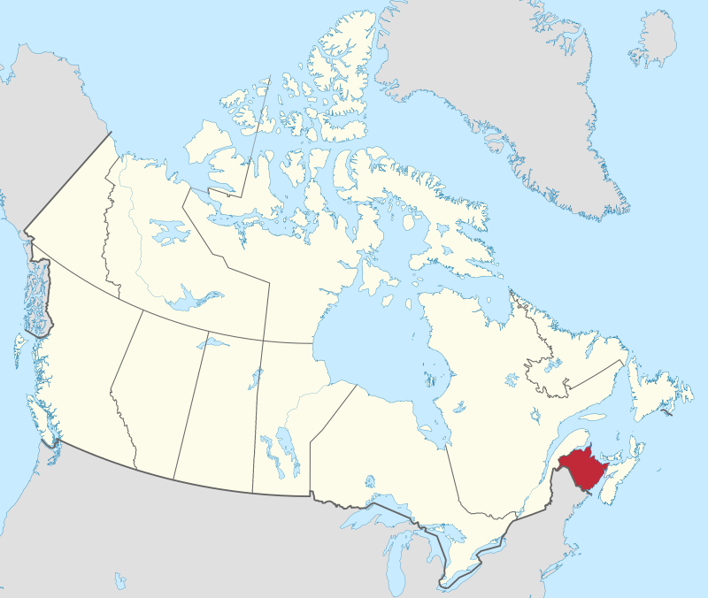
New Brunswick
By MapGrid - Own work, CC BY-SA 4.0, https://commons.wikimedia.org/w/index.php?curid=98179027

Slide 3
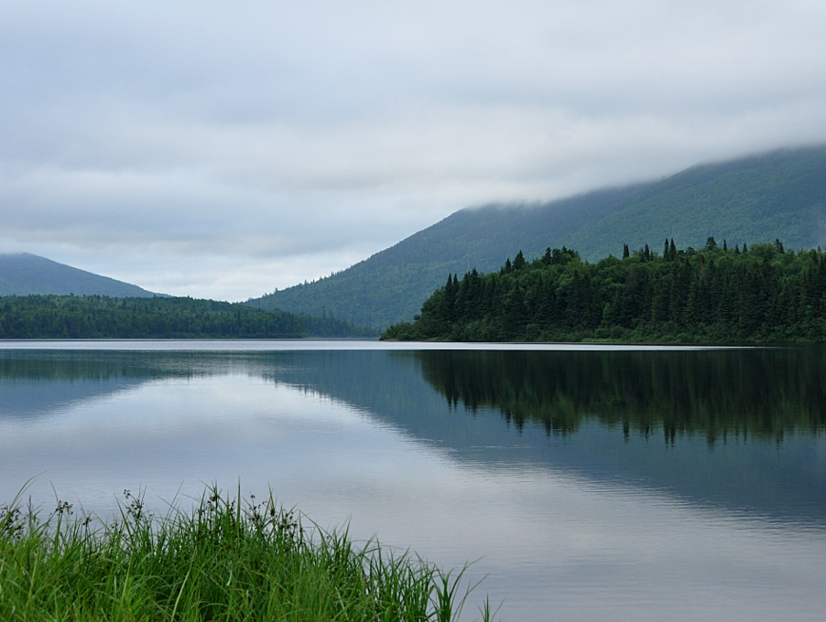
Mount Carleton Provincial Park
Top of the Appalachian Mountains
By User:Magicpiano - Own work, CC BY-SA 4.0, https://commons.wikimedia.org/w/index.php?curid=69348740

Slide 4
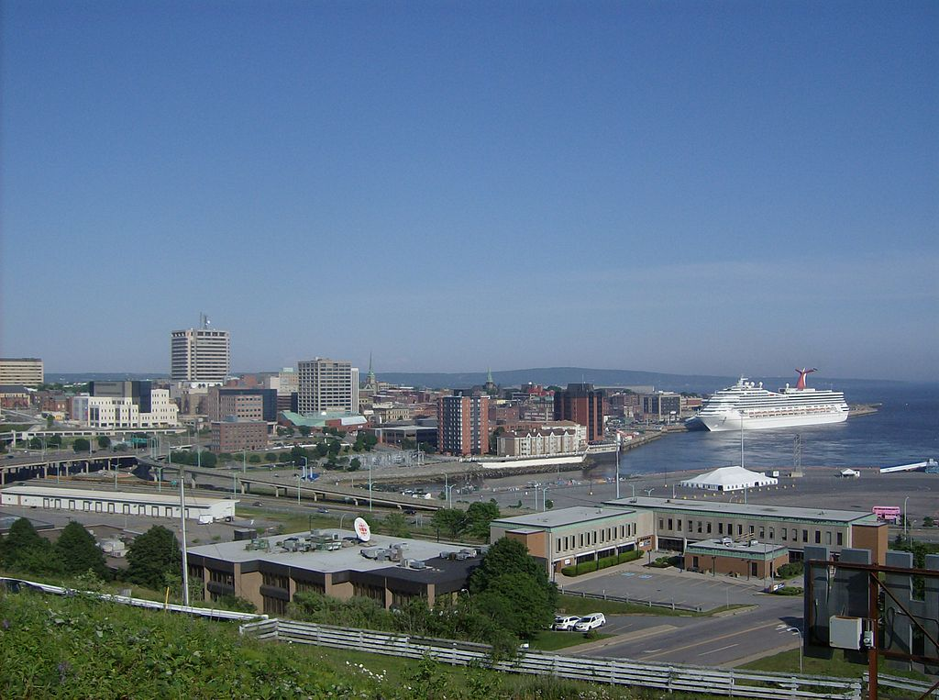
Saint John
By Cusack5239 - Own work, CC BY-SA 3.0, https://commons.wikimedia.org/w/index.php?curid=20085088

Slide 5
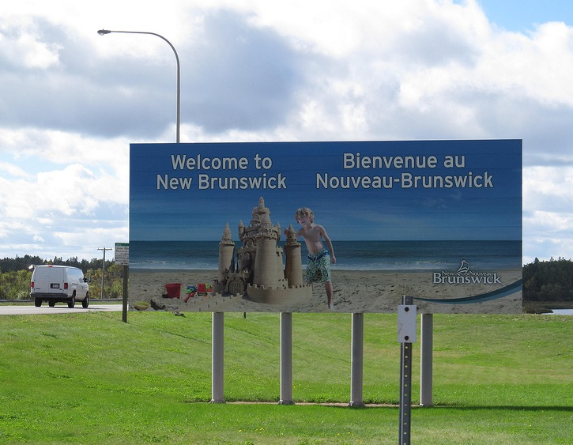
English/French
New Brunswick was a French colony before the English overtook it
By Doug Kerr - Flickr photo, CC BY-SA 2.0, https://commons.wikimedia.org/w/index.php?curid=65982903

Slide 6
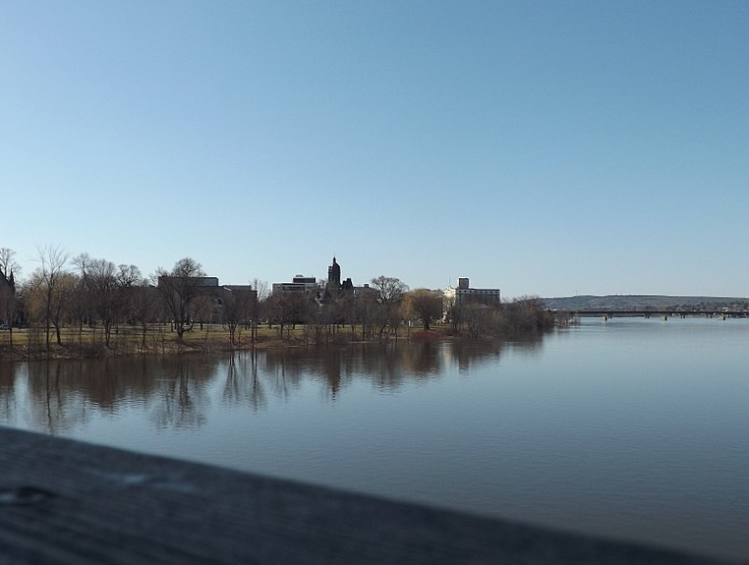
Fredericton
Capital
By Knoxfordguy at English Wikipedia, CC BY-SA 3.0, https://commons.wikimedia.org/w/index.php?curid=41618743

