Slide 1
Manitoba
Glorious and Free

Slide 2
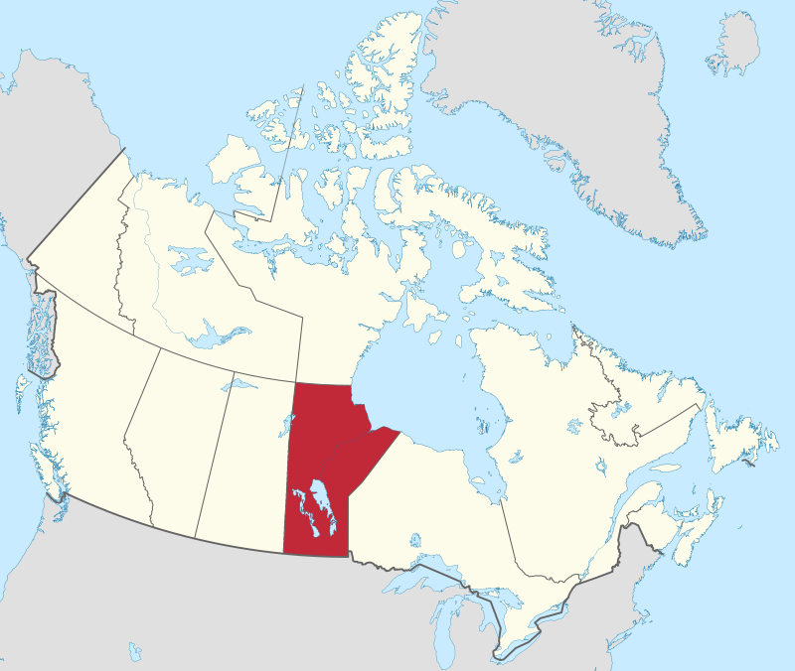
Manitoba
By MapGrid - Own work, CC BY-SA 4.0, https://commons.wikimedia.org/w/index.php?curid=98178923

Slide 3
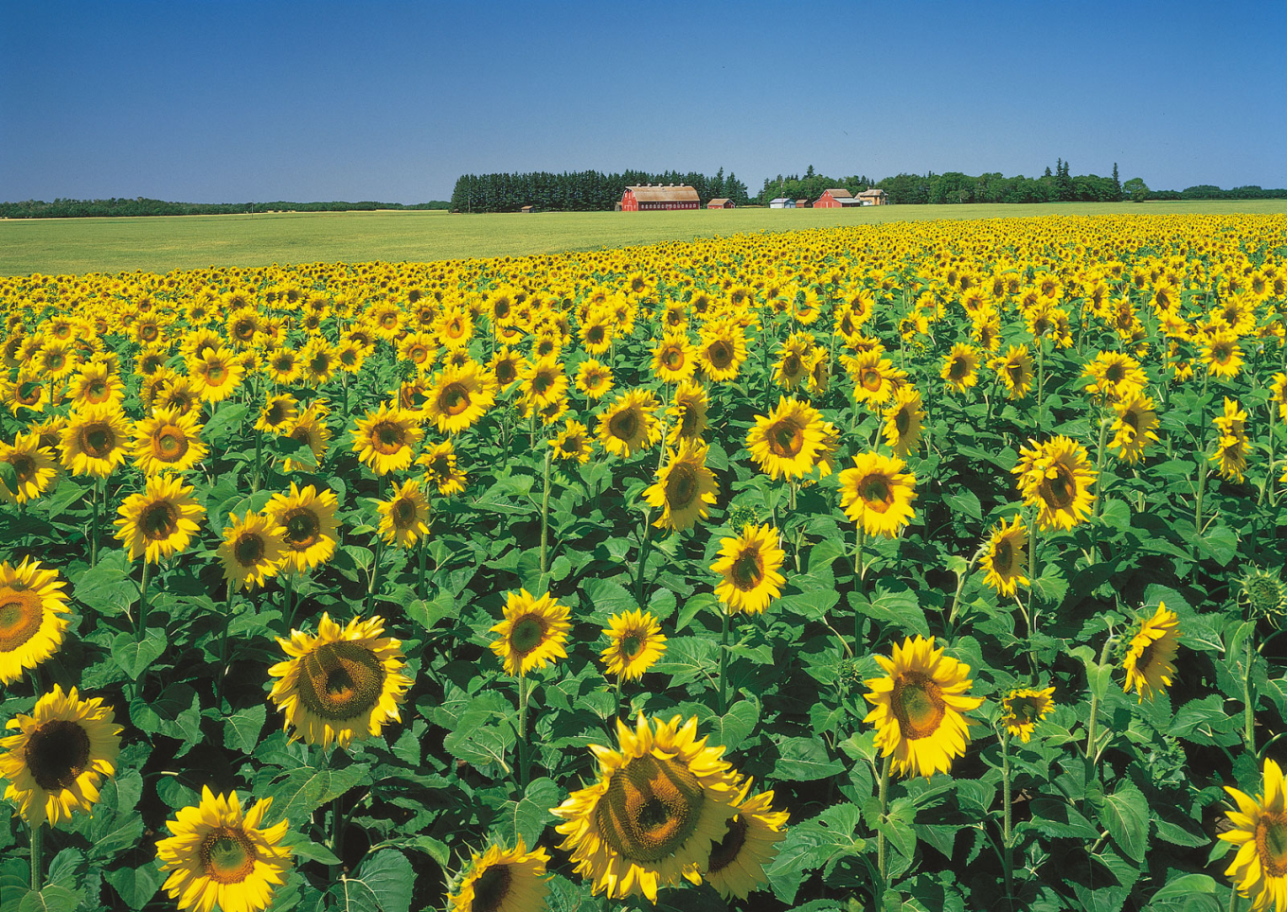
Agriculture
https://cdn.britannica.com/82/7082-050-566913BA/Field-sunflowers-farm-valley-Assiniboine-River-Manitoba.jpg

Slide 4
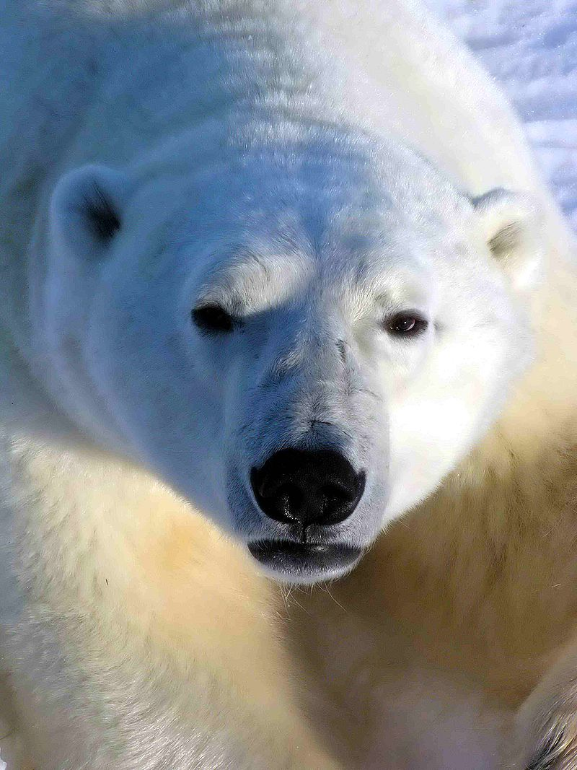
Polar Bears
There are many polar bears in northern Manitoba. Churchill, Manitoba is known as the “Polar Bear Capital.”
By Ansgar Walk - photo taken by Ansgar Walk, CC BY 2.5, https://commons.wikimedia.org/w/index.php?curid=905226

Slide 5
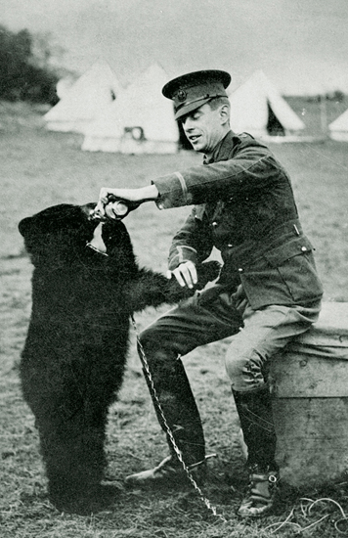
Winnipeg the Bear

Slide 6
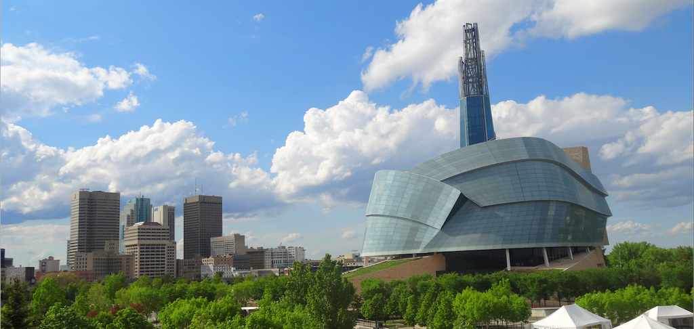
Winnipeg
By Krazytea - Own work, CC BY-SA 4.0, https://commons.wikimedia.org/w/index.php?curid=98582402

