Slide 1
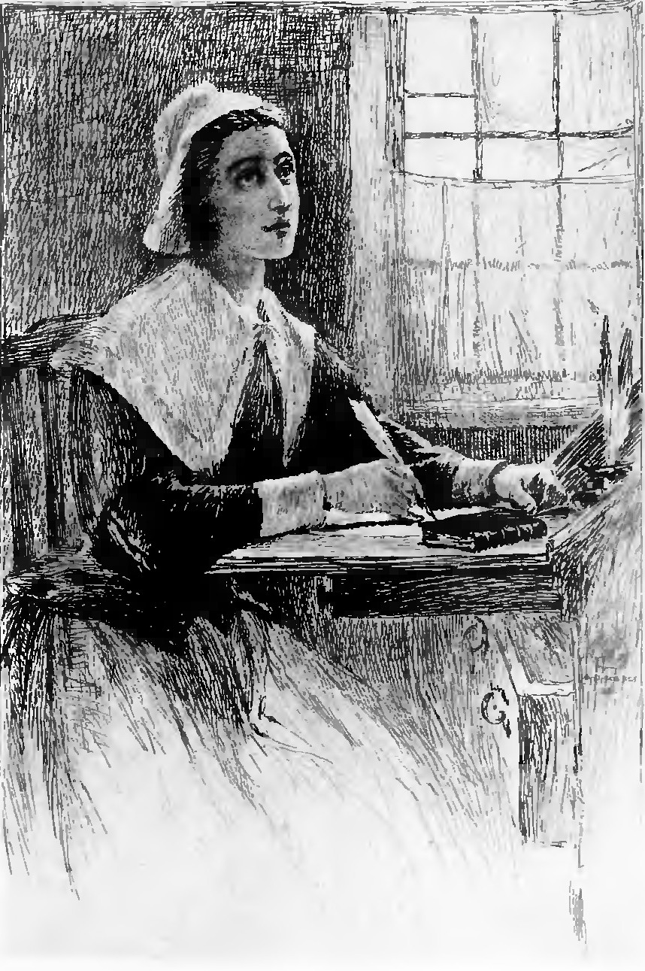
Anne Bradstreet (c. 1612–1672)
Born in England; received informal but rigorous classical education
With husband, joined John Winthrop’s 1630 Massachusetts Bay enterprise
Collection of poems, The Tenth Muse Lately Sprung in America, published in London in 1650; widely read and well-received
Common themes: devotional, theological, domestic (mother of 8)
“Historically, metaphorically, and even biologically mother of American poetry…” (Eberwein 161)
Notes:
Anne Bradstreet (c. 1612–1672)
Author(s): Jane Donahue Eberwein
Source: Legacy, Vol. 11, No. 2 (1994), pp. 161-169
Published by: University of Nebraska Press
Stable URL: https://www.jstor.org/stable/25679134

Slide 2

“The Author to Her Book” by Anne Bradstreet
Thou ill-form’d offspring of my feeble brain,
Who after birth didst by my side remain,
Till snatched from thence by friends, less wise than true,
Who thee abroad, expos’d to publick view,
Made thee in raggs, halting to th’ press to trudge,
Where errors were not lessened (all may judg).
At thy return my blushing was not small,
My rambling brat (in print) should mother call,
I cast thee by as one unfit for light,
Thy Visage was so irksome in my sight;
Yet being mine own, at length affection would
Thy blemishes amend, if so I could:
I wash’d thy face, but more defects I saw,
And rubbing off a spot, still made a flaw.
I stretched thy joynts to make thee even feet,
Yet still thou run’st more hobling then is meet;
In better dress to trim thee was my mind,
But nought save home-spun Cloth, i’ th’ house I find.
In this array ’mongst Vulgars mayst thou roam.
In Criticks hands, beware thou dost not come;
And take thy way where yet thou art not known,
If for thy Father askt, say, thou hadst none:
And for thy Mother, she alas is poor,
Which caus’d her thus to send thee out of door.

Slide 3
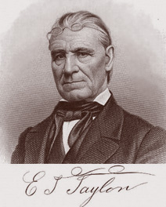
Edward Taylor (c. 1645-1729)
Join English Puritan migration to America in 1668.
Graduated from Harvard then pastored frontier congregation of Westfield for remainder of his life.
Style heavily influenced by English metaphysical poets, particularly George Herbert.
Largest collection of poetry, Preparatory Meditations, written for private devotional use. Not published until 1939.
Notes:
Anne Bradstreet (c. 1612–1672)
Author(s): Jane Donahue Eberwein
Source: Legacy, Vol. 11, No. 2 (1994), pp. 161-169
Published by: University of Nebraska Press
Stable URL: https://www.jstor.org/stable/25679134

Slide 4
“Meditation One” by Edward Taylor
What love is this of Thine, that cannot be
In Thine infinity, O Lord, confined,
Unless it in Thy very Person see
Infinity and Finity conjoined?
What! hath Thy godhead, as not satisfied,
Married our manhood, making it its bride?
Oh, matchless love! filling heaven to the brim!
O’erunning it, all running o’er beside
This world! Nay, overflowing hell, wherein
For Thine elect there rose a mighty tide!
That there our veins might through Thy Person bleed
To quench those flames that else would on us feed.
Oh! that thy love might overflow my heart
To fire the same with love! For love I would,
But oh! my straitened breast! my lifeless spark!
My fireless flame! What chilly love and cold!
In measure small! in manner chilly! See!
Lord, blow the coal, Thy love enflame in me.

Slide 5
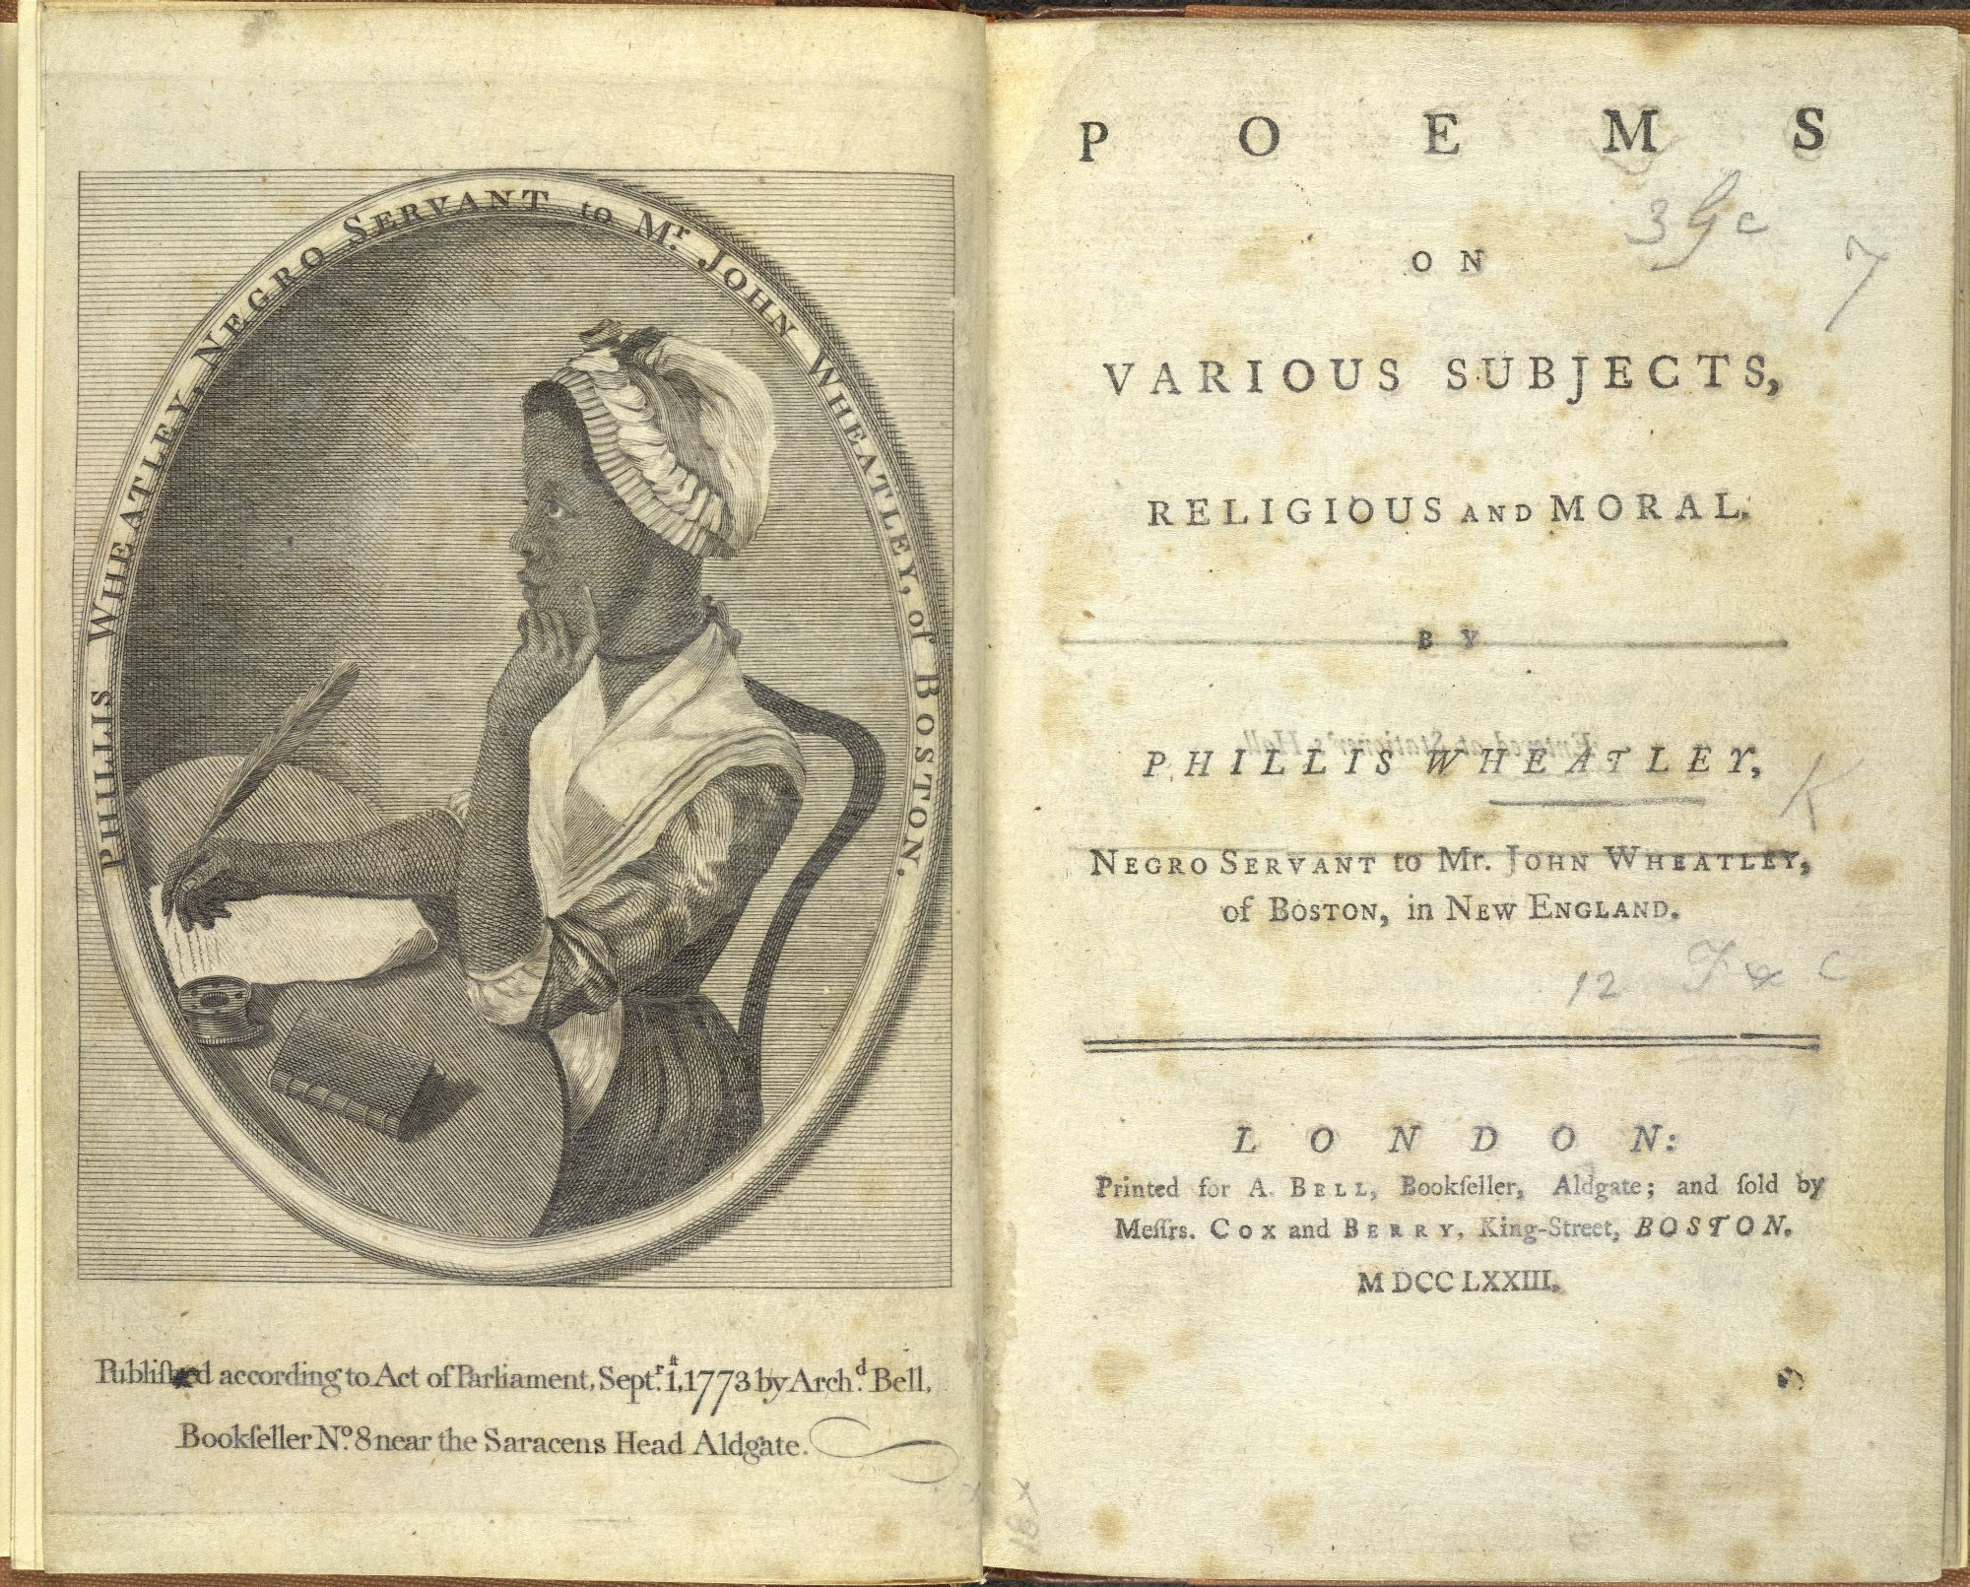
Phillis Wheatley (c. 1753-1784)
Second American woman to publish book of poems.
Enslaved as young girl and sold to Wheatley family in Boston.
Received good education; began writing poems at age 13.
Achieved international fame for Poems on Various Subjects, Religious and Moral.
Granted freedom after publication of book.
Died poor and relatively unknown at age 31.
Notes:
Anne Bradstreet (c. 1612–1672)
Author(s): Jane Donahue Eberwein
Source: Legacy, Vol. 11, No. 2 (1994), pp. 161-169
Published by: University of Nebraska Press
Stable URL: https://www.jstor.org/stable/25679134

Slide 6
“On Being Brought from Africa to America” by Phillis Wheatley
‘Twas mercy brought me from my Pagan land,
Taught my benighted soul to understand
That there’s a God, that there’s a Saviour too:
Once I redemption neither sought nor knew.
Some view our sable race with scornful eye,
“The colour is a diabolic die.”
Remember, Christians, Negroes, black as Cain,
May be refin’d, and join th’ angelic train.

