Slide 1
Alberta
Strong and Free

Slide 2
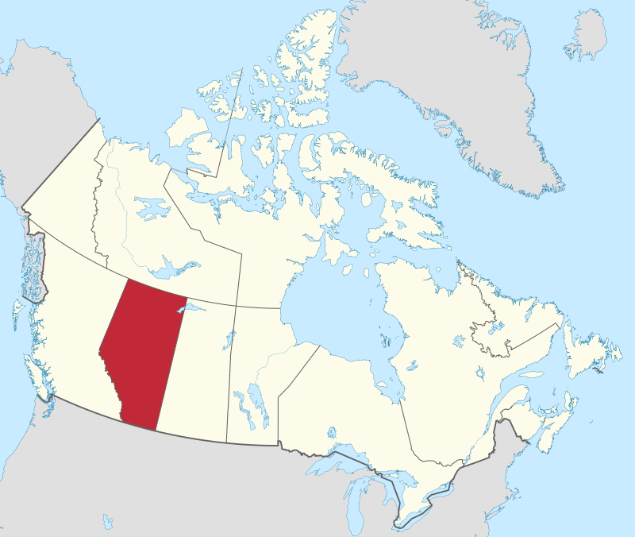
Alberta
By MapGrid - Own work, CC BY-SA 4.0, https://commons.wikimedia.org/w/index.php?curid=98178783

Slide 3
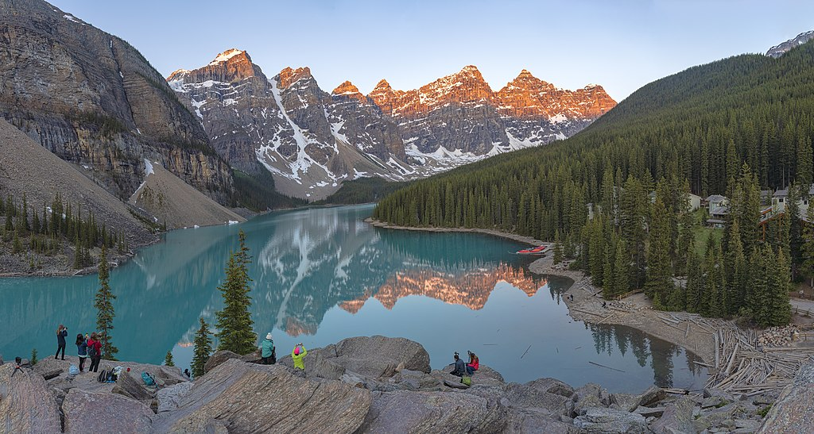
Alberta Mountain Forrests
By Chensiyuan - Own work, CC BY-SA 4.0, https://commons.wikimedia.org/w/index.php?curid=79770717

Slide 4
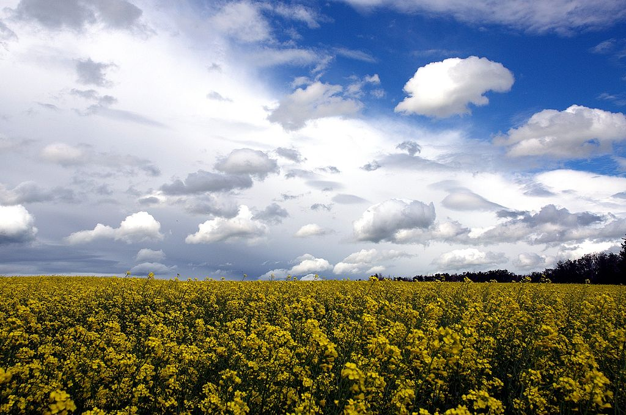
Prairies
By Darren Kirby from Edmonton, AB, Canada - CanolaUploaded by Skeezix1000, CC BY-SA 2.0, https://commons.wikimedia.org/w/index.php?curid=15917949

Slide 5
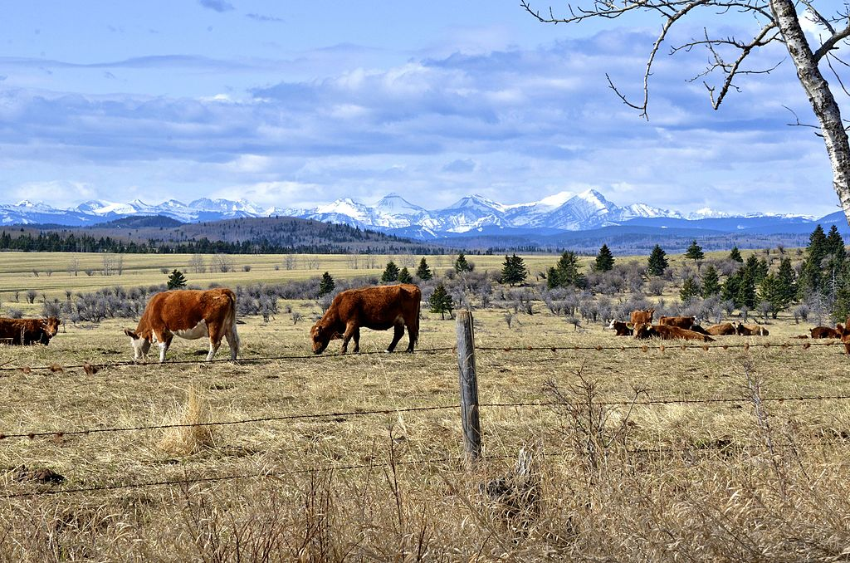
Almost half of Canada’s beef is grown in Alberta
By Jack Borno, CC BY-SA 3.0, https://commons.wikimedia.org/w/index.php?curid=56982124

Slide 6
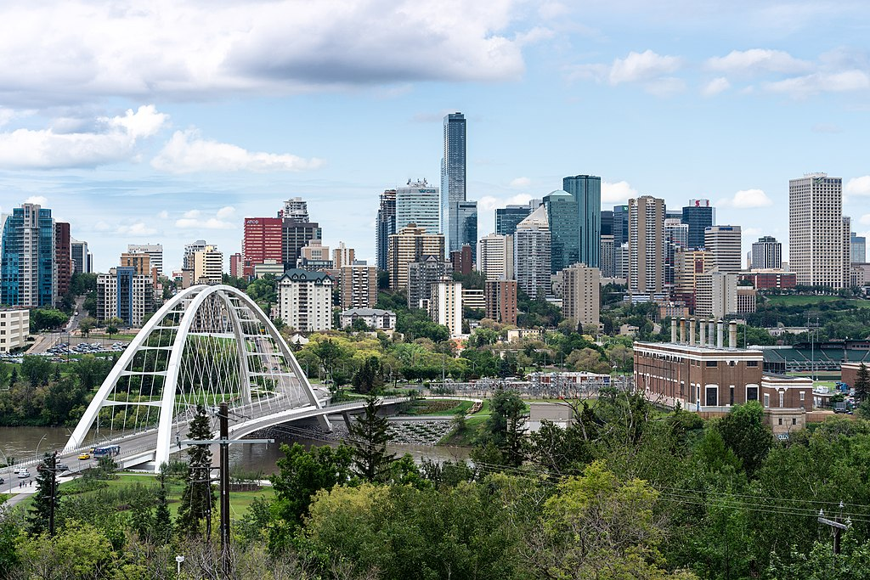
Edmonton
By Explore Edmonton - https://exploreedmonton.com/, CC BY-SA 4.0, https://commons.wikimedia.org/w/index.php?curid=101266925

