Slide 1
Mennonites and the American Revolution
65-Church History

Slide 2
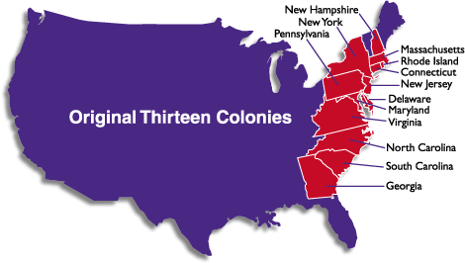

Slide 3
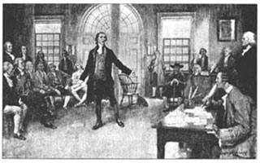

Slide 4
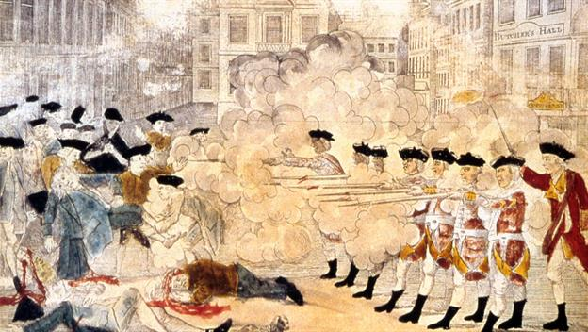

Slide 5
