Slide 1
Mennonite Settlement in America
Church History 62

Slide 2
Notes:
Insert map of modern Germany, circling the area of the Palatinate.

Slide 3
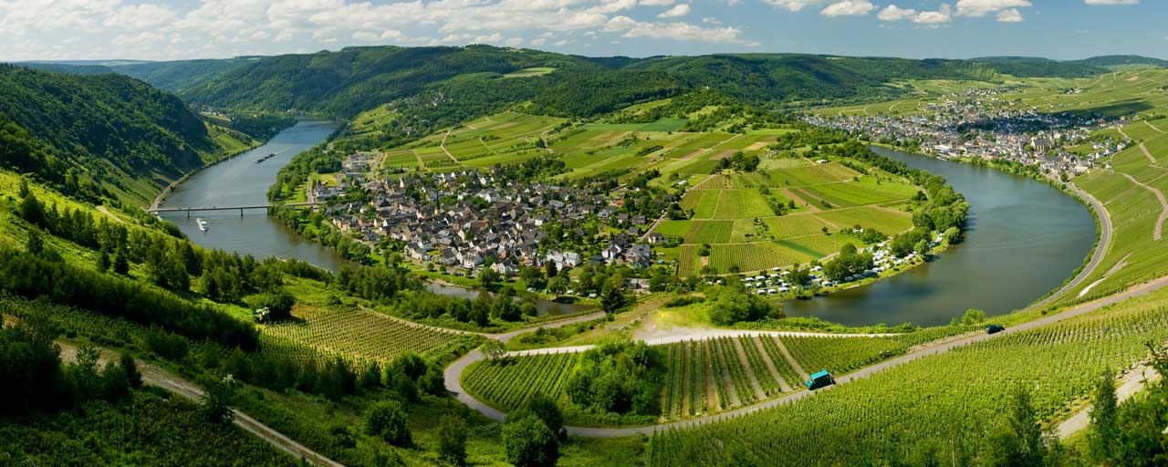
The Palatinate

Slide 4
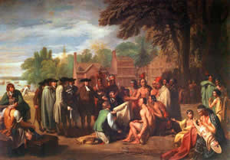
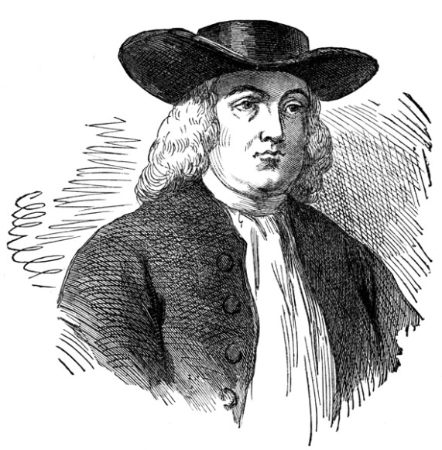
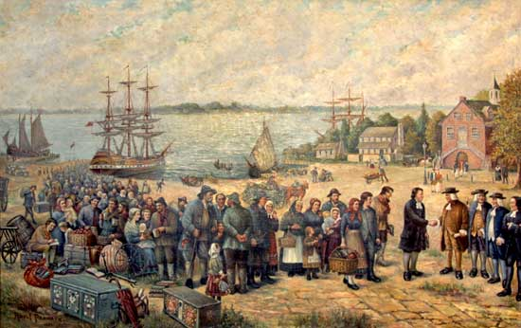
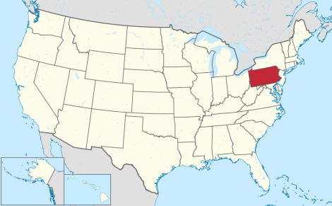
William Penn and his Experiment in America

Slide 5
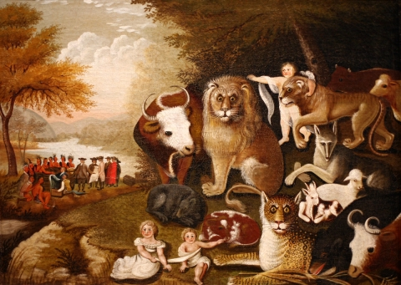
The Peacable Kingdom
-Edward Hicks

Slide 6
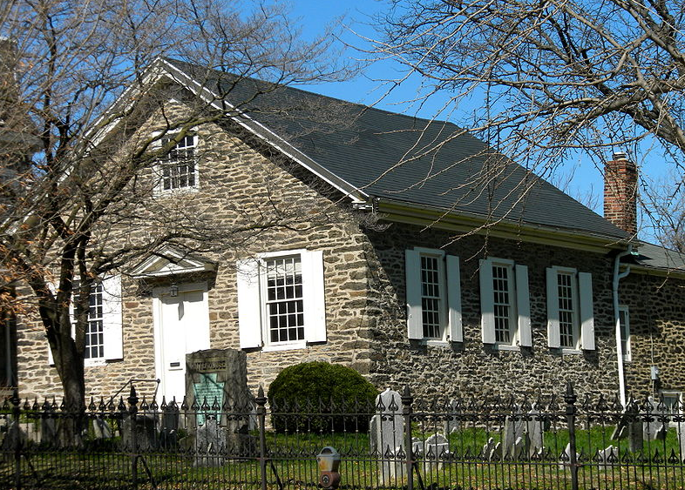

Slide 7
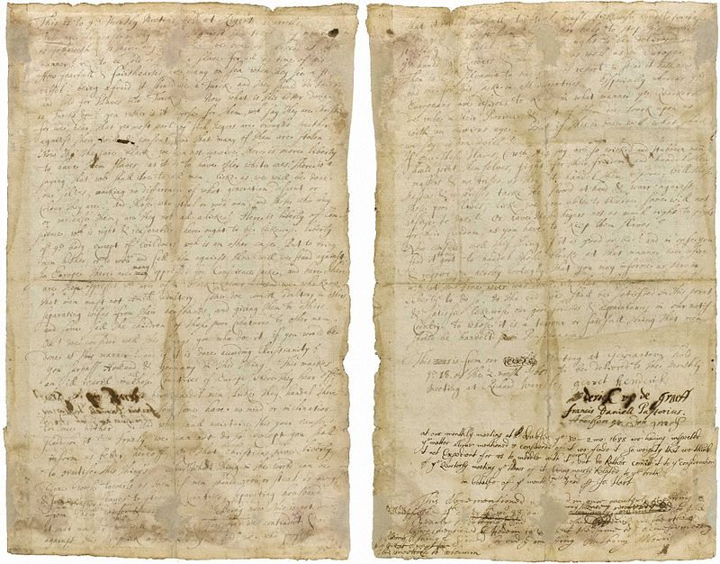

Slide 8
Notes:
Insert map of the northeast region of the United States to show where the Amish and Mennonites first settled in the United States.

