Slide 1
Mennonites in Russia
54-Church History

Slide 2
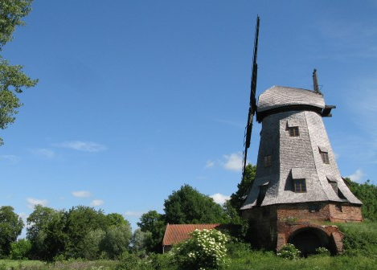
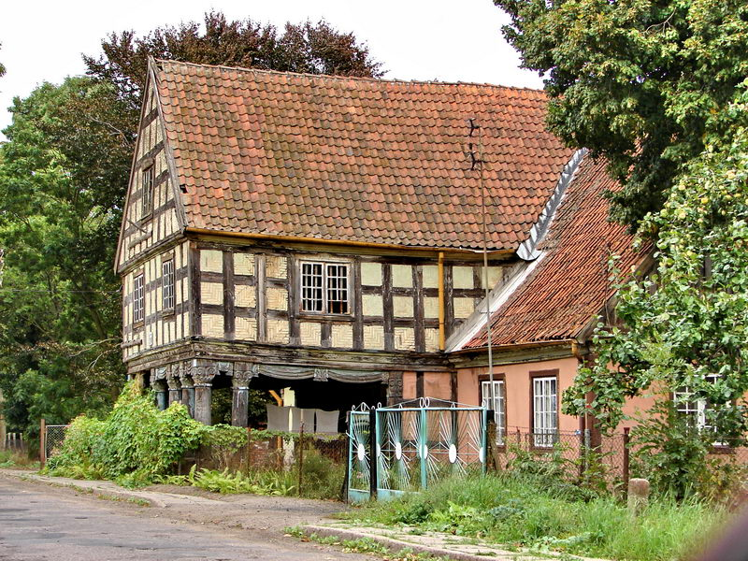

Slide 3
Notes:
Add map showing the area in Poland where the Mennonites lived to where they moved into Russia.

Slide 4
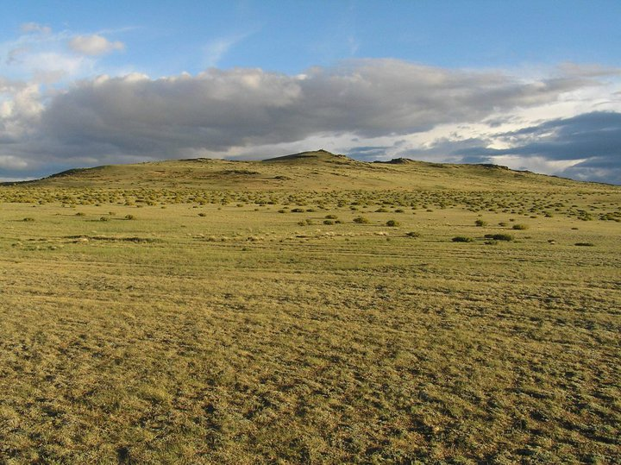
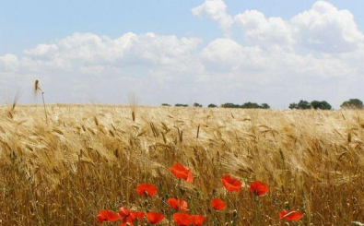
The Ukrainian Steppes

Slide 5

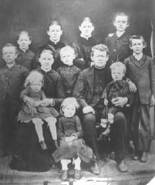
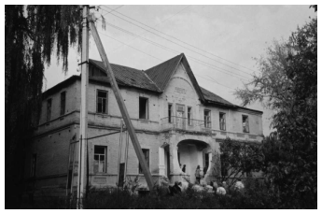

Slide 6
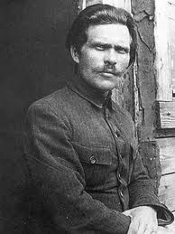
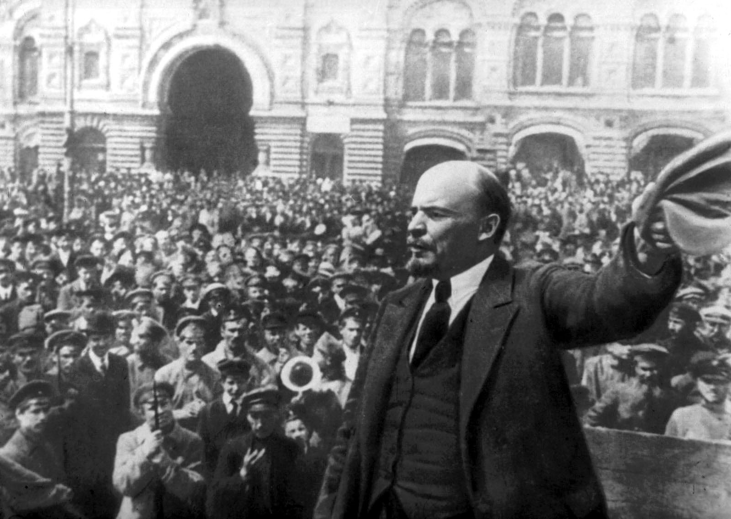
Nester Makhno
Bolshevik Revolution

Slide 7
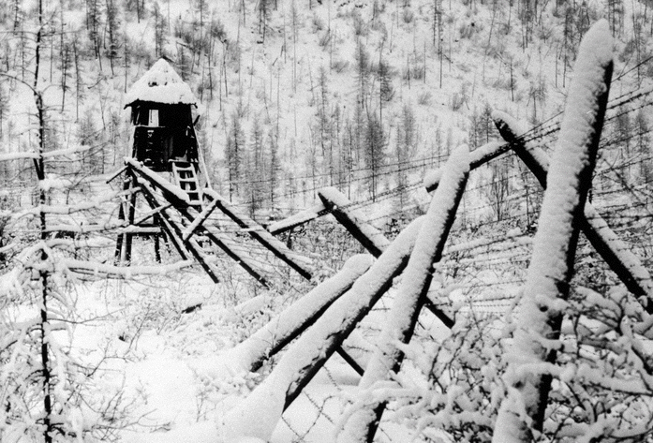

Notes:
Add map of Russia showing with Siberia marked. Add picture of men working in the camp found at this link: http://www.openminds.tv/wp-content/uploads/Gulag-work-camp.jpg

Slide 8
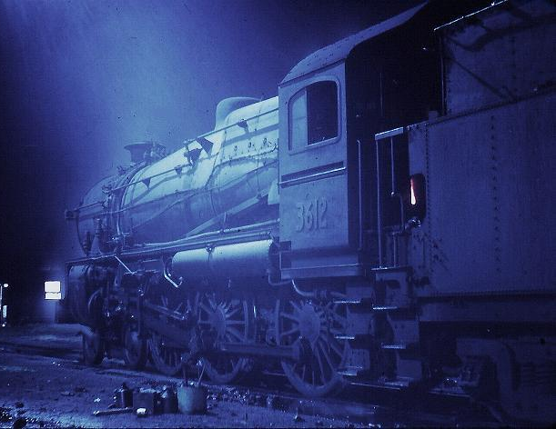

Slide 9
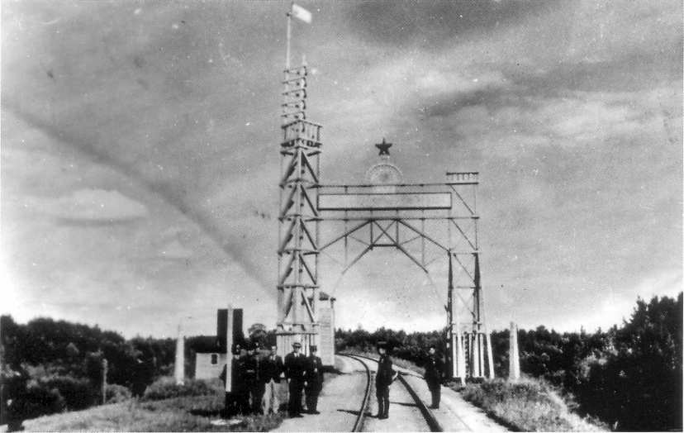
The Red Gate

Slide 10


