Slide 1
Menno Simons
50 and 51- Church History

Slide 2
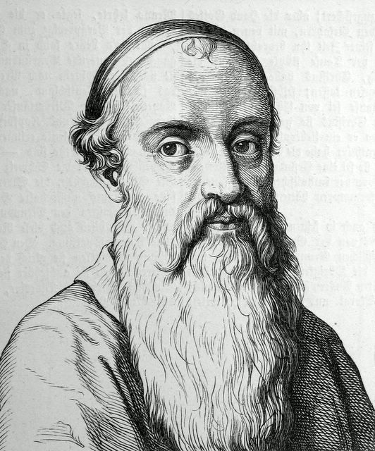
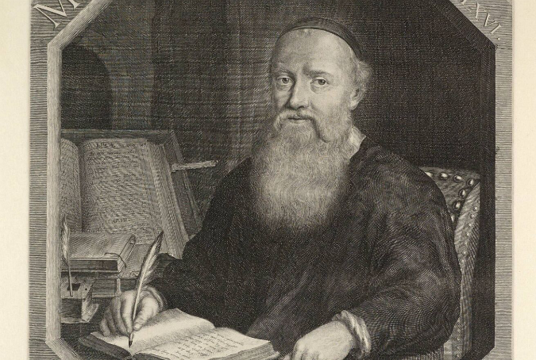

Slide 3
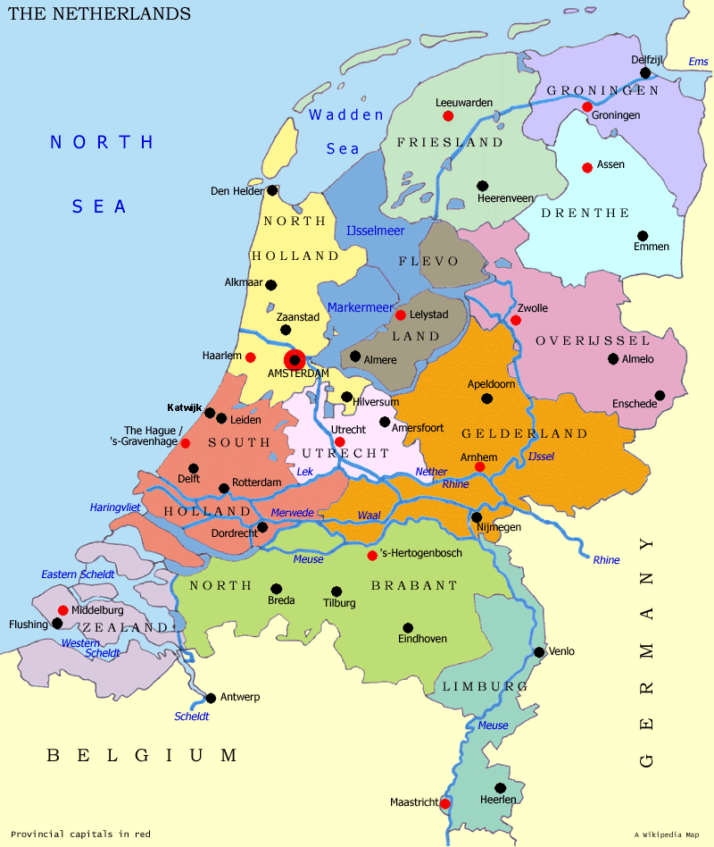
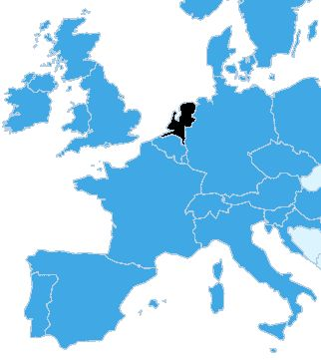

Slide 4
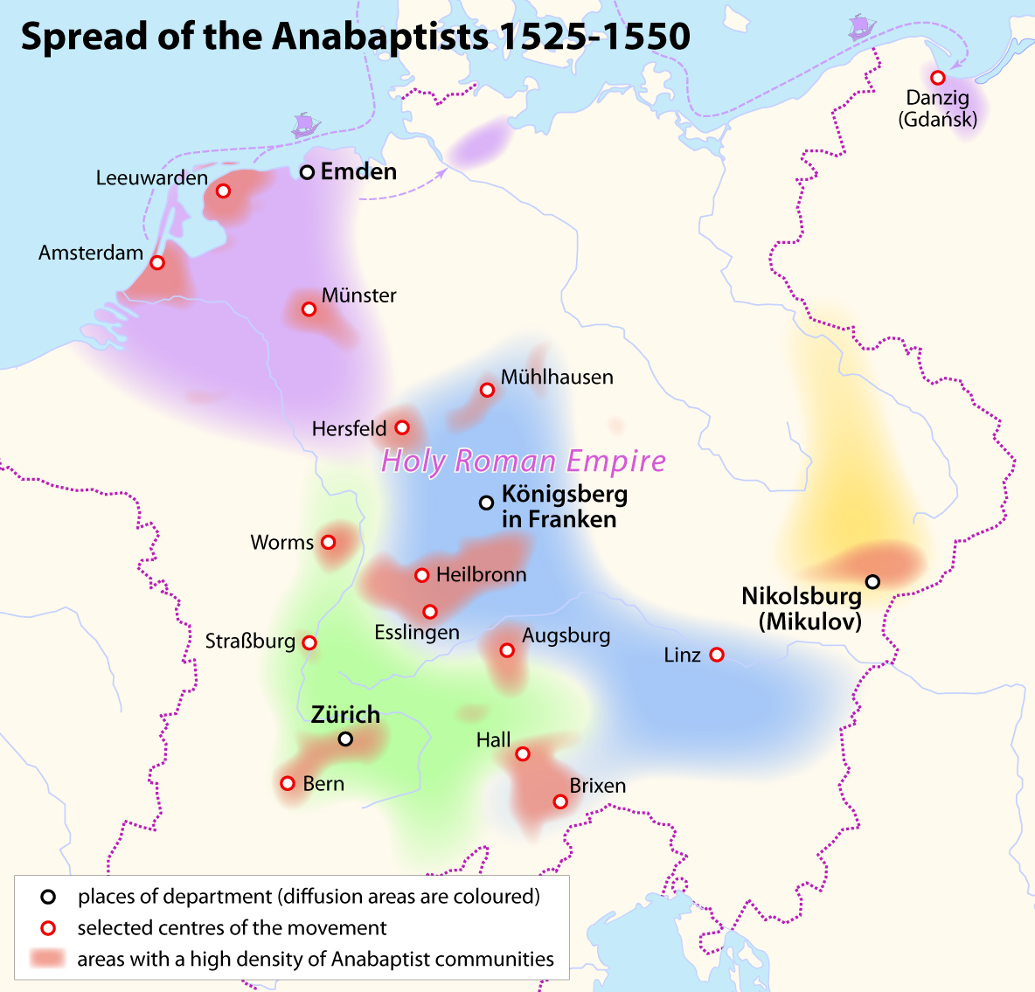
Notes:
Add map of the spread of the Anabaptists 1525-1550

Slide 5


Slide 6
