Slide 1
Church in the New Testament Era
Church History-Mr. Myers

Slide 2

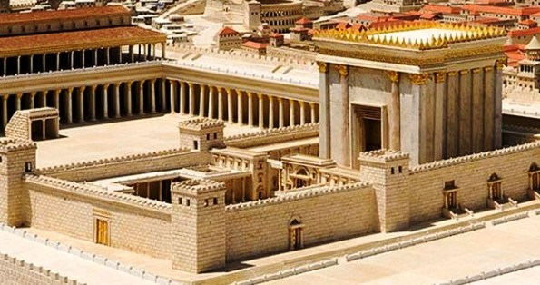

Slide 3
Notes:
From worldatlas, add map of the countries that border the Mediterranean Sea. Also include map of Palestine in Christ’s time.

Slide 4
Notes:
Add map of Paul’s missionary journeys.

Slide 5
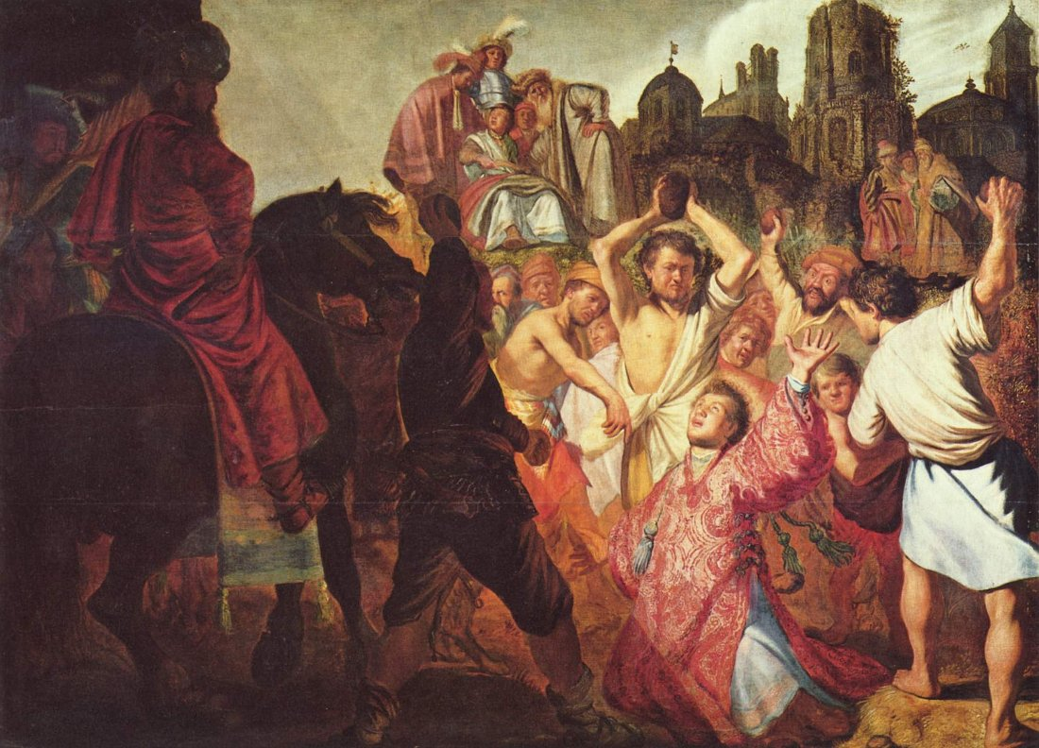

Slide 6
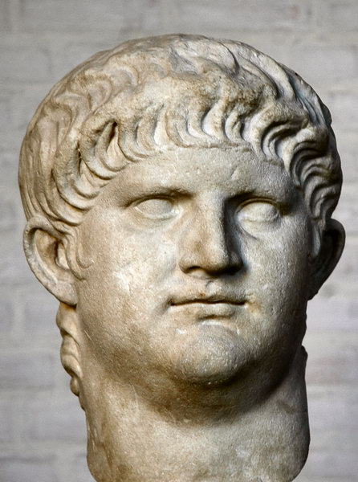
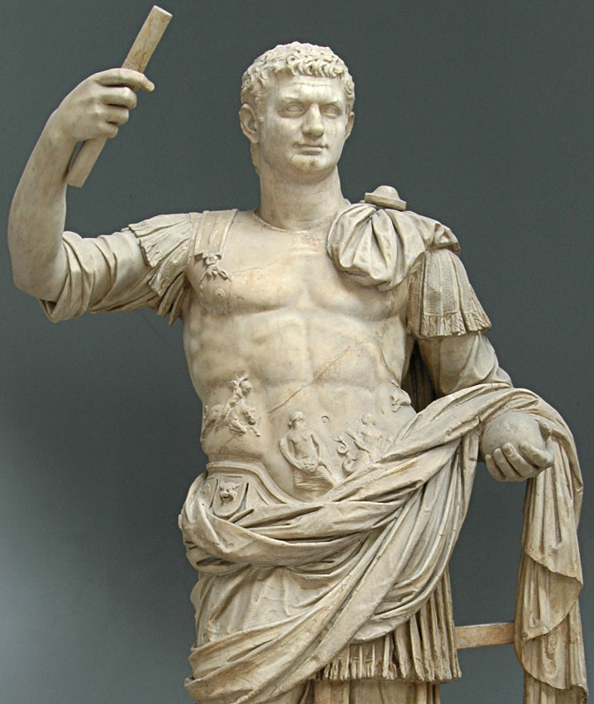

Slide 7


