Slide 1
Hutterite Anabaptists
49-Church History

Slide 2
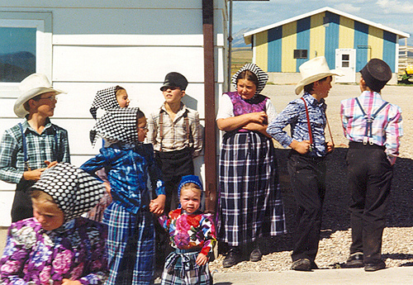


Hutterites

Slide 3
Hutterite Colonies
Notes:
Add map showing where Hutterite colonies are today.

Slide 4


Slide 5
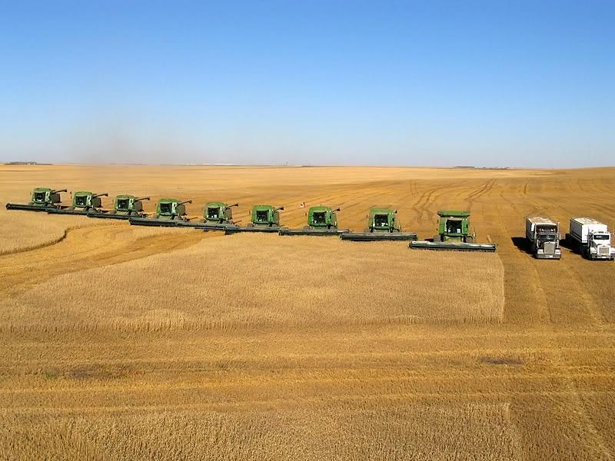

Slide 6

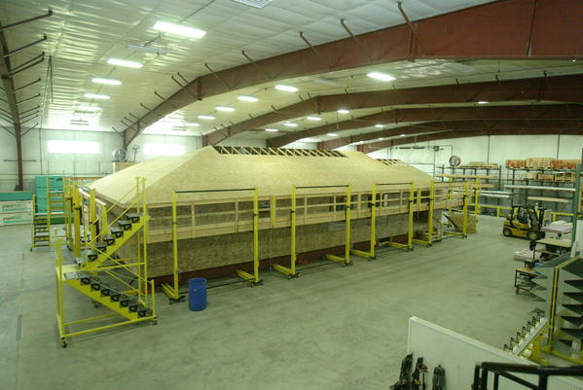

Slide 7
Notes:
Add map showing the spread of Anabaptists 1525-1550.

Slide 8
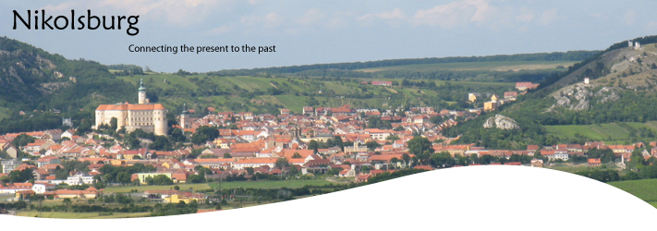
Hutterite Beginnings

Slide 9
Notes:
Add map showing the Hutterite migrations in Europe (1526-1874)

Slide 10



