Slide 1
German Anabaptism
48-Church History

Slide 2
Notes:
Add map of the spread of Anabaptism in Europe, 1525-1550.

Slide 3
Hans Denck
Notes:
Find image of Denk online/

Slide 4
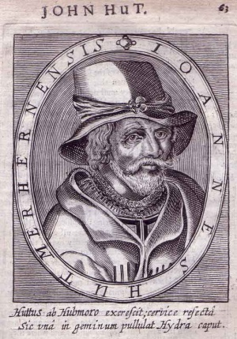
Hans Hut

Slide 5

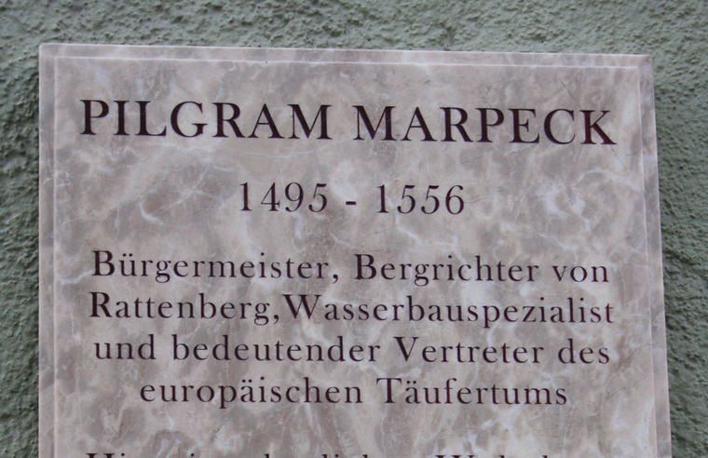
Pilgram Marpeck

