Slide 1
Michael Sattler:
Life and Legacy
45-Church History

Slide 2
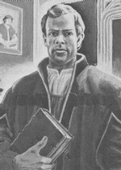
Michael SAttler

Slide 3
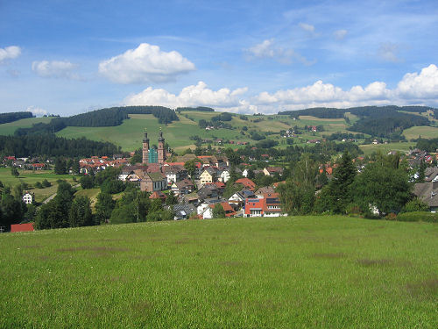

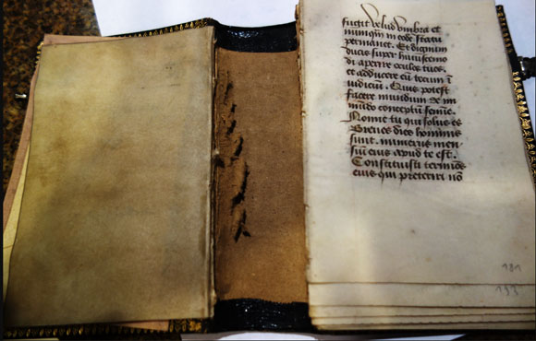
M. Sattler: Bio
Born around 1490 near Freiburg, Germany
Entered a Benedictine monastery at an early age
Received an education in languages and theology
Became a leader in the monastery of St. Peter’s

Slide 4
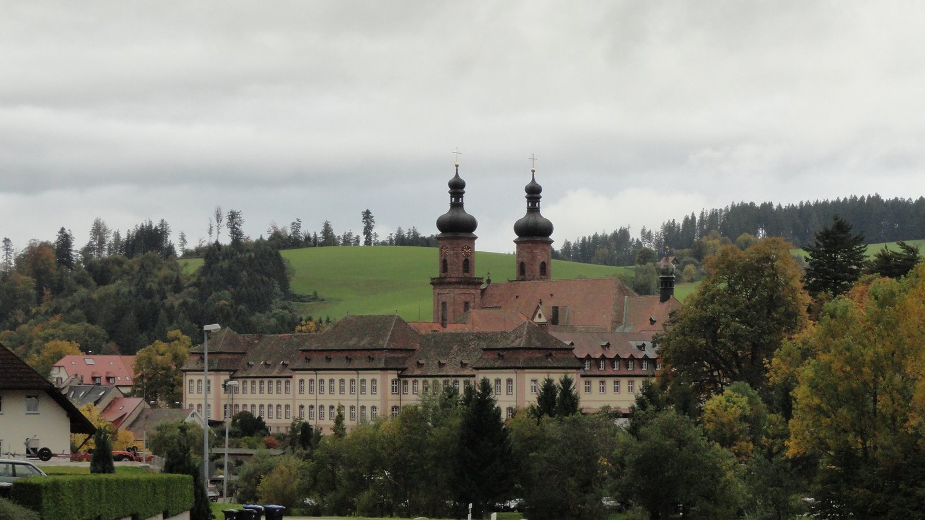

Slide 5

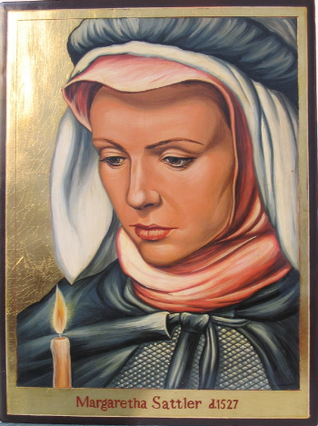
M. Sattler: Conversion
While a monk, Sattler heard about some of the new ideas of the Reformation and began studying Paul’s epistles to figure out the truth, and as a result, came to repentance and faith in Christ
Disappointed with the monasticism and the Catholic Church, Michael left the monastery and married a former nun named Margaretha
In late 1525, Michael learned to know and joined the Anabaptists in Zurich

Slide 6
M. Sattler: Death
(see dramatic reading)
In 1527, Sattler, his wife, and a number of other Anabaptists were arrested in northern Switz.
He was put on trial in a militantly Catholic province and accused of breaking imperial as well as ecclesiastical laws
He presented a bold defense with many appeals to the Scripture but was condemned to be burned at the stake
He was martyred on May 20, 1527
Margaretha was drowned two days later

Slide 7
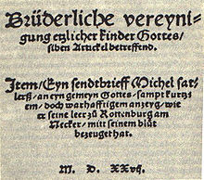
M. Sattler: importance
Provided solid, stabilizing leadership in the wake left by the disappearance of the first generation of Anabaptist leaders (Grebel, Manz, Blaurock)
Drafted the Schleitheim Confession which gave the Anabaptists a source of unity and identity
Wrote numerous letters and articles that helped to articulate Anabaptist beliefs

