Slide 1
The church comes to life
Church History-Mr. Myers

Slide 2
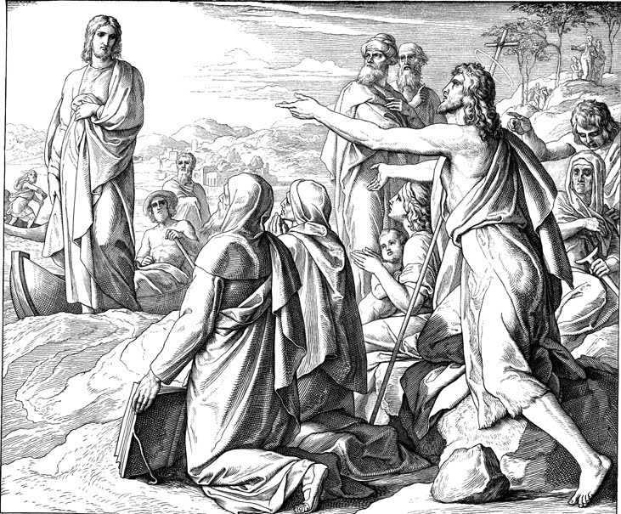
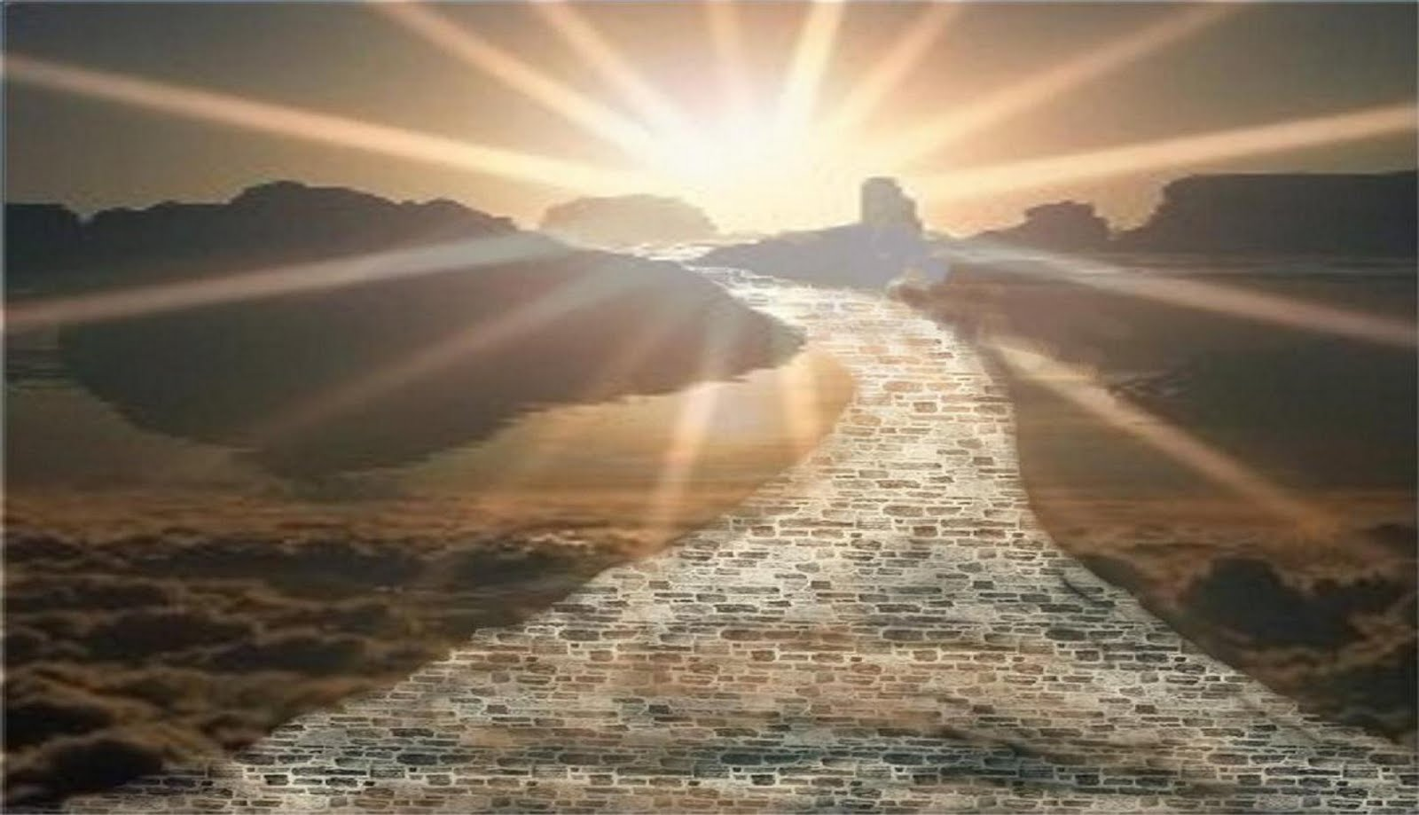
John The Baptist

Slide 3


Slide 4
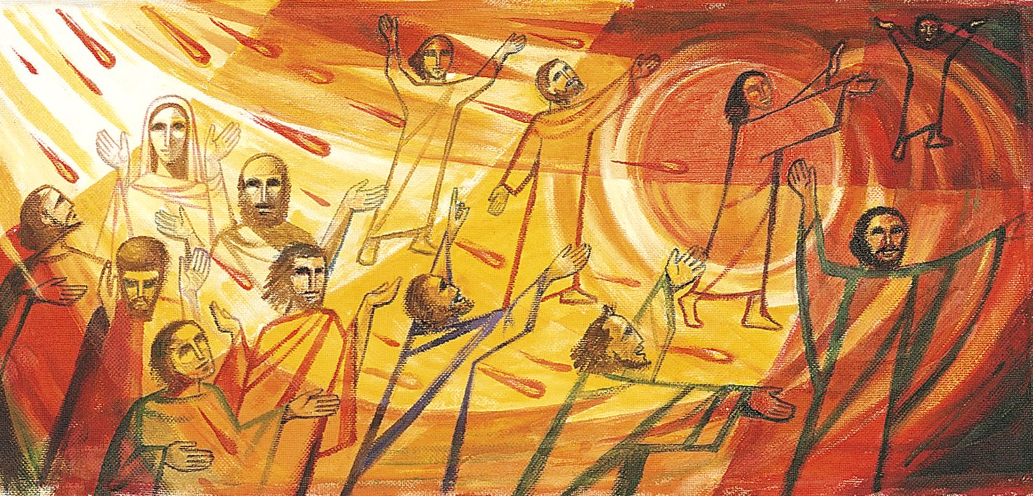
Pentecost-A.D. 33

Slide 5


What is the church?

Slide 6


The church

