Slide 1
The major Split
Church History-22

Slide 2

Hagia sophia in Constantinople

Slide 3
Notes:
Add map showing the division of the Eastern and Western segments of the church.

Slide 4
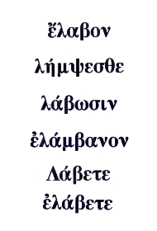


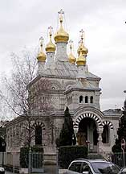
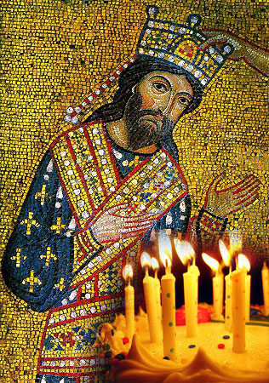
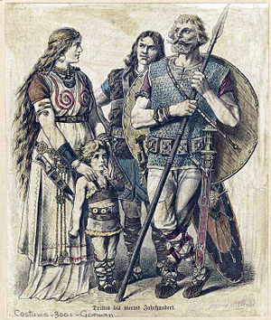
Notes:
Add map showing the eastern and western divisions of the church.

Slide 5
Notes:
Add map of the spread of Christianity from 300 to 1300 A.D.

Slide 6
West VS. East
Latin
Latin/Germanic
Germanic tribes
Western theology
“Authority” of pope
Greek
Greek/Slavic
Byzantine Empire
Eastern theology
“Authority” of Patriarch

Slide 7
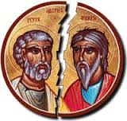
Notes:
Add map of the east/west schism of 1054.

Slide 8




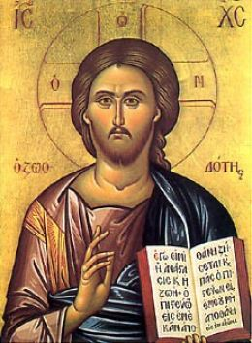


Slide 9



