Slide 1
Development of the papacy
Church History-21

Slide 2
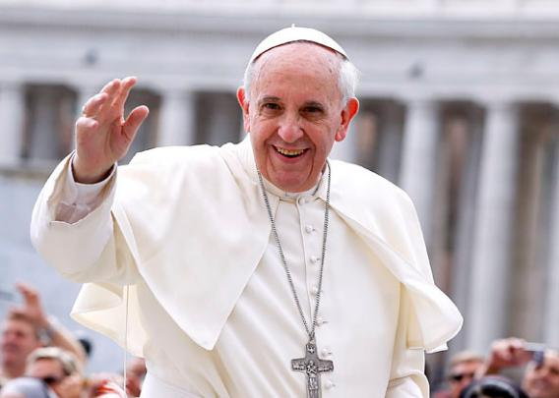
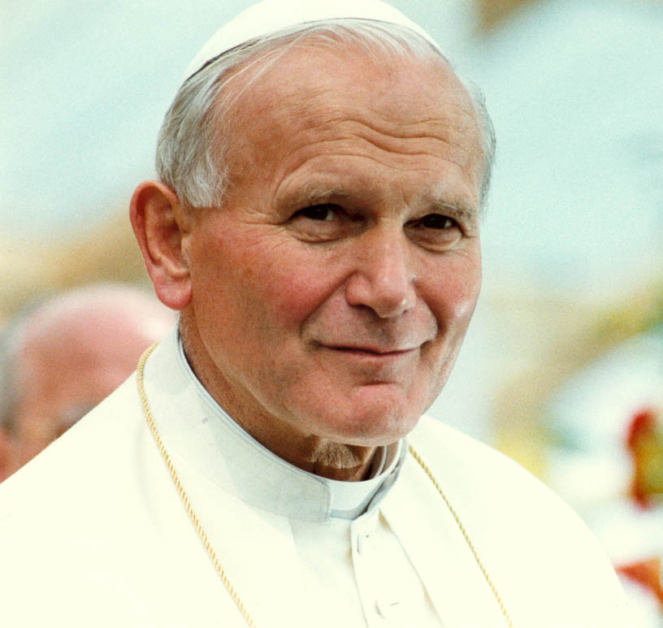
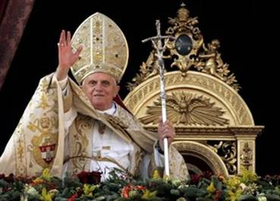

Slide 3
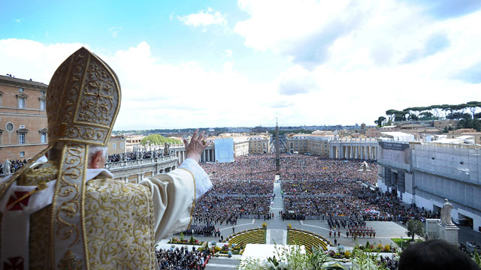
Power of the pope

Slide 4
Notes:
Add map of the region of the local churches of the Bible. Previous map was found at www.bible.ca

Slide 5
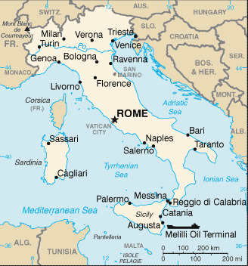
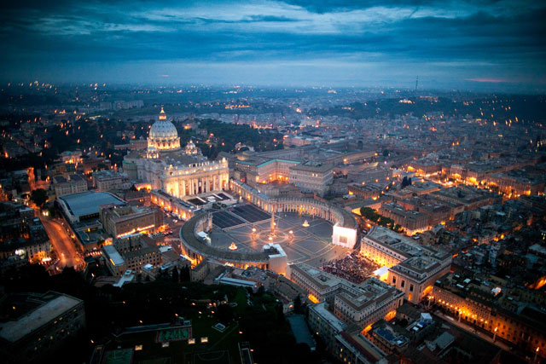

Church in Rome

