Slide 1
Rise of Islam
20-Church History

Slide 2
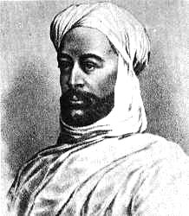
Setting: Arabia
Notes:
Add map of Saudi Arabia with major cities.

Slide 3
Trade routes in middle east
Notes:
Add map of trade routes in the middle east during the middle ages.

Slide 4
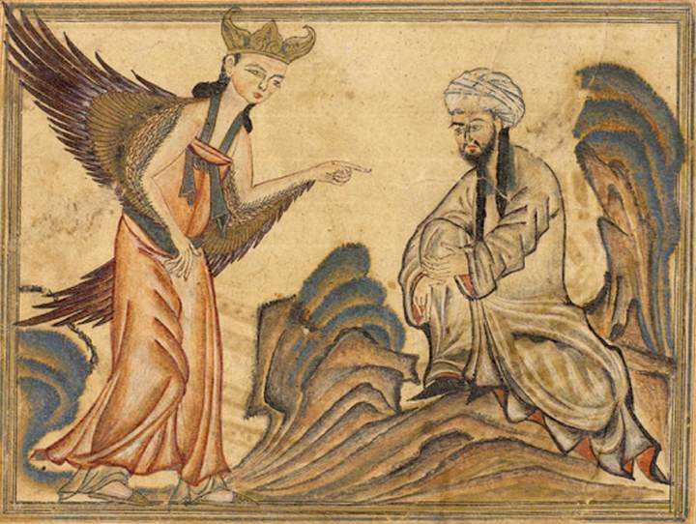

“Revelations”

Slide 5
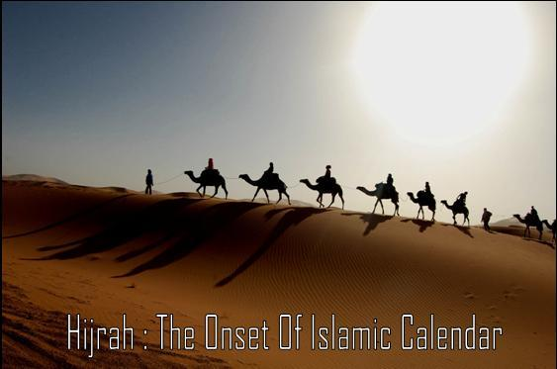
A.D. 622
Notes:
Add map of Saudi Arabia, highlighting Mecca and Medina.

Slide 6
Notes:
Add map showing the spread of Islam.

