Slide 1
The church and the decline of Rome
17-Church History

Slide 2
Notes:
Map was here “From Chadwick and Evans, Atlas of the Christian Church” The Spread of Christianity, 300-600

Slide 3
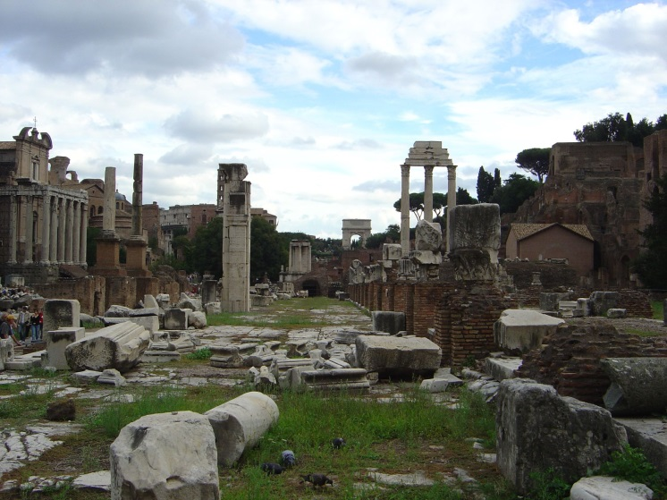
Reasons for Decline
Rome’s political disorder
      No policy for choosing emperors
      Unending assassinations and fighting
Economic disorder
      Expense of huge army
      Uncontrolled inflation
Moral decay
      Laziness and greed
      Moral promiscuity rampant

Slide 4
Division of the Roman Empire
Notes:
Map of Deocletian’s tetrarchy divisions.

Slide 5
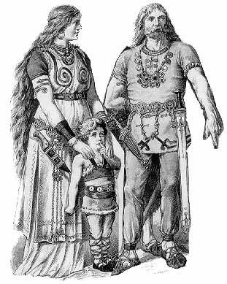
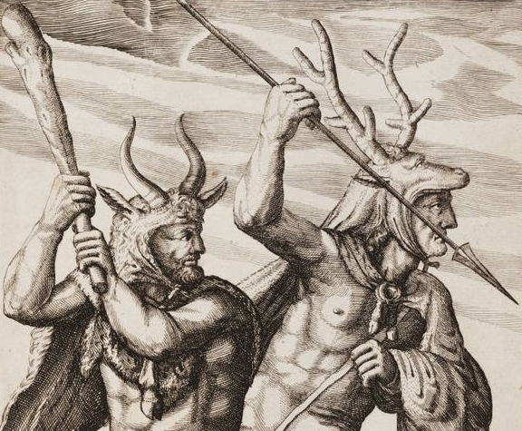
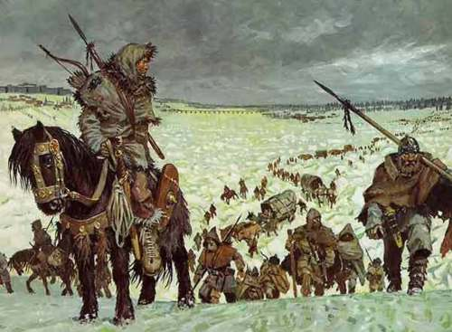
The Barbarians

Slide 6
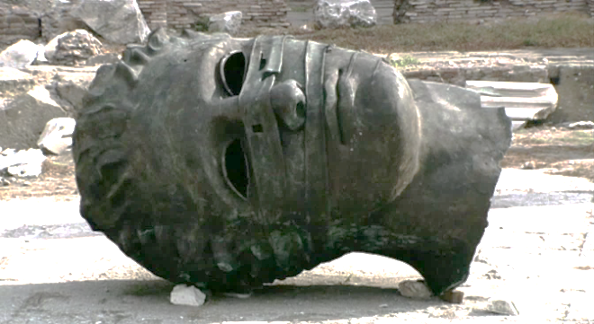
Collapse of the
Roman Empire
Fall of Rome—A.D. 476
Eastern half of the empire continues as the Byzantine Empire
Notes:
Add map showing area controlled by the Byzantine Empire after the fall of Rome.

Slide 7
Notes:
Add map of Europe showing the tribes that controlled the areas around the Eastern Roman Empire in 477 AD

Slide 8
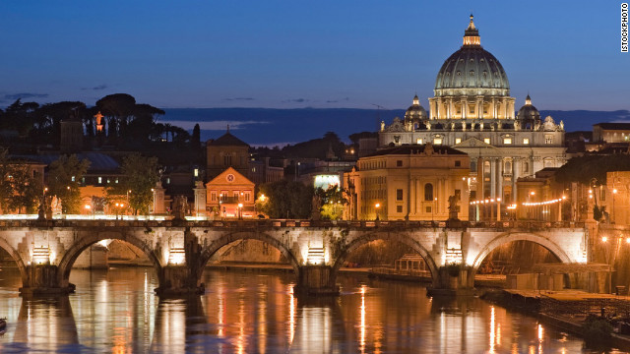
Effect on Church
As the Western Roman Empire disintegrated, the church assumed much of the Empire’s former role as provider of stability, unity, and authority
Arian or pagan at the time of the invasions, the Germanic tribes converted to the Catholicism of the Roman church over time.
The Roman Catholic Church was the only institution enjoying widespread respect and authority in western Europe.

