Slide 2
Notes:
Add map of Europe showing the districts controlled by the emperors Constantius, Maximian, Galerius, and Diocletian.

Slide 3
Notes:
Add map showing Constantine’s campaign and the growth of land under his control.

Slide 4
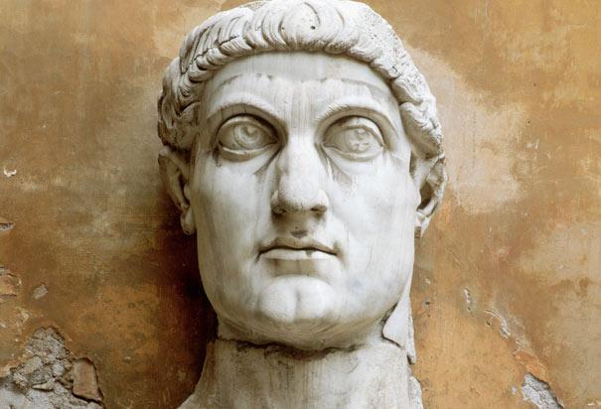
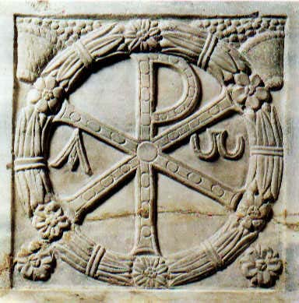

Slide 5
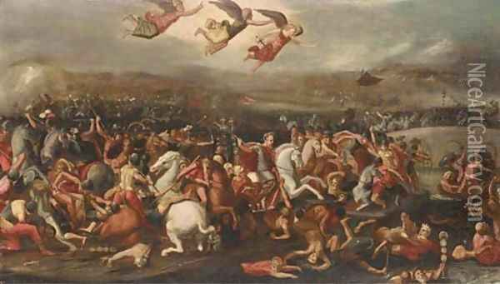
Battle of Milvian Bridge

Slide 6
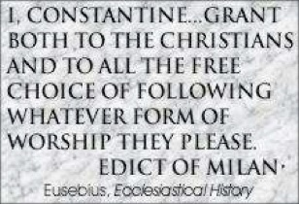
Edict of Milan, 313

Slide 7
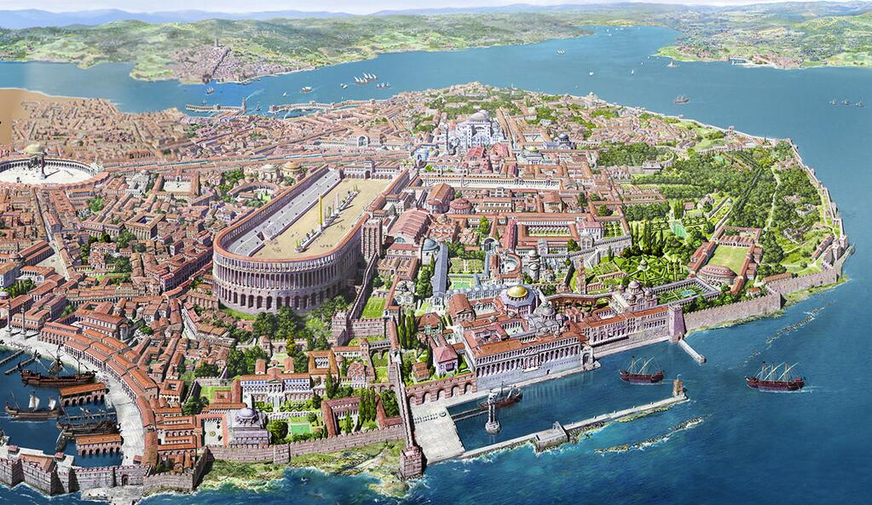
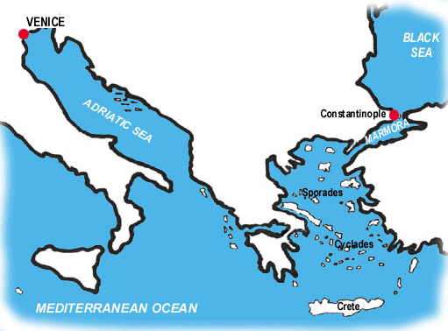

Slide 8
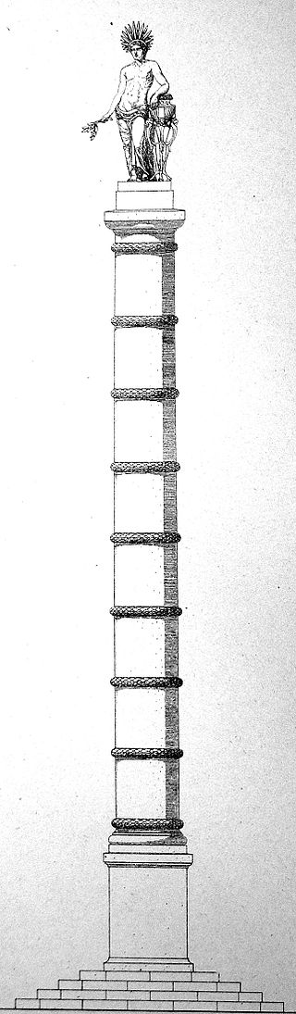
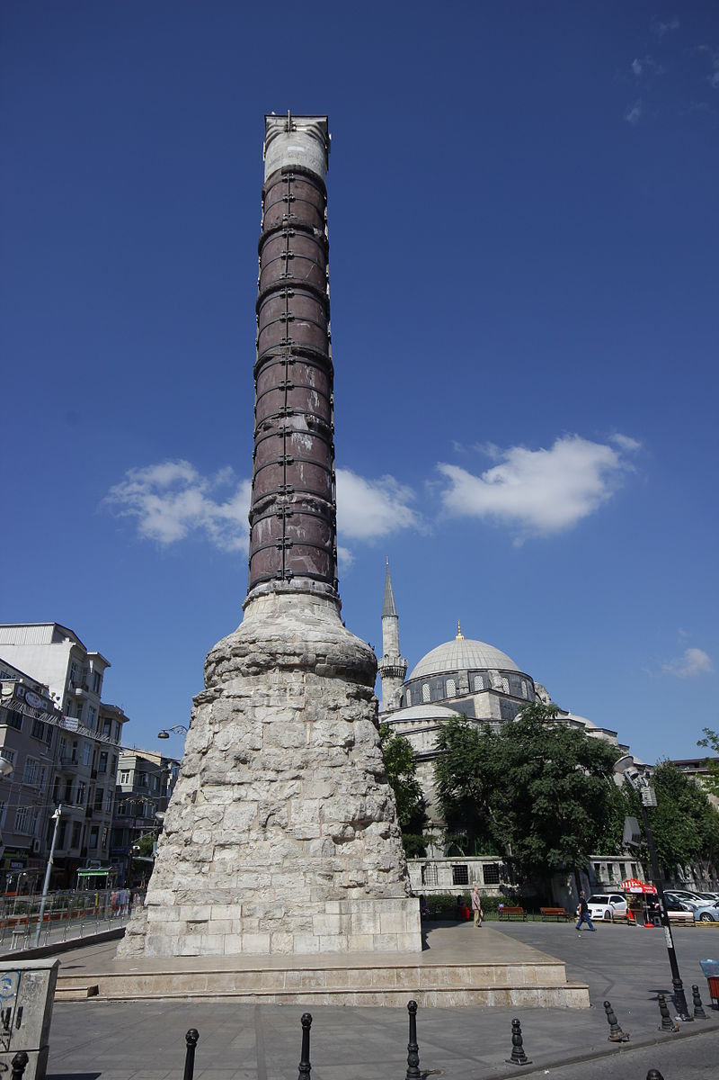

Slide 9
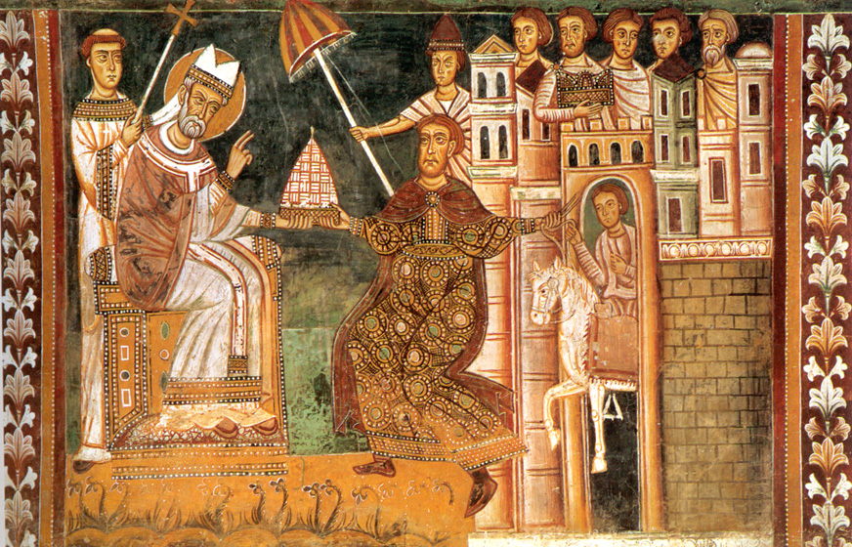
Imperial control of church

Slide 10
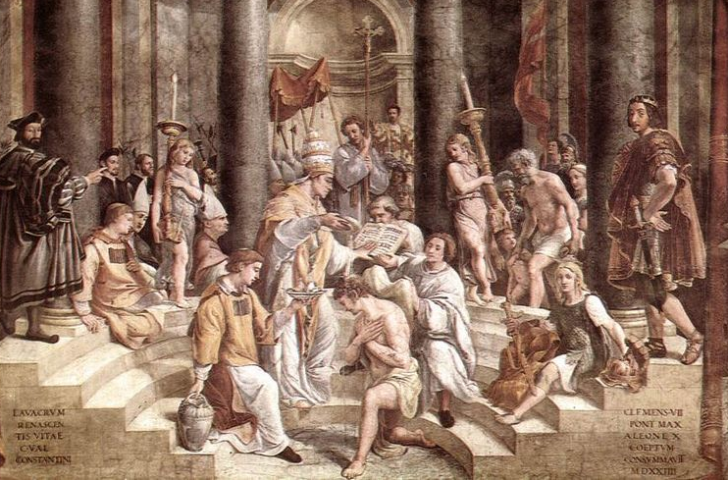
Baptism of Constantine

Slide 11


