Slide 1
The church in roman society
Church History 10

Slide 2

In what ways was the Christian church a countercultural movement
in the Roman Empire?
What values and ideas did it embrace in opposition to the prevailing winds of its time?

Slide 3
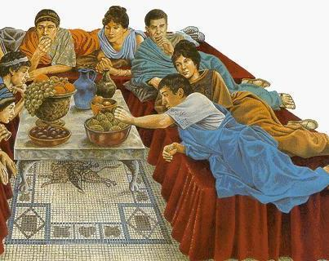
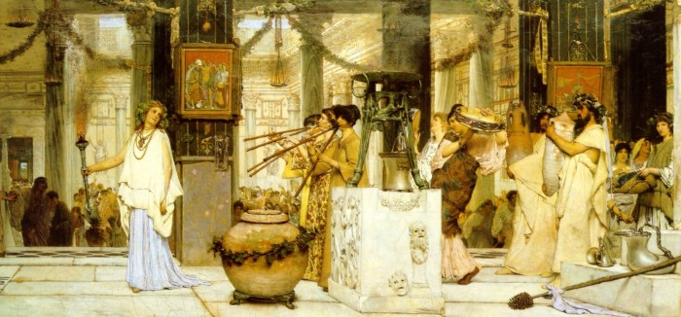
Affluent and comfortable

Slide 4
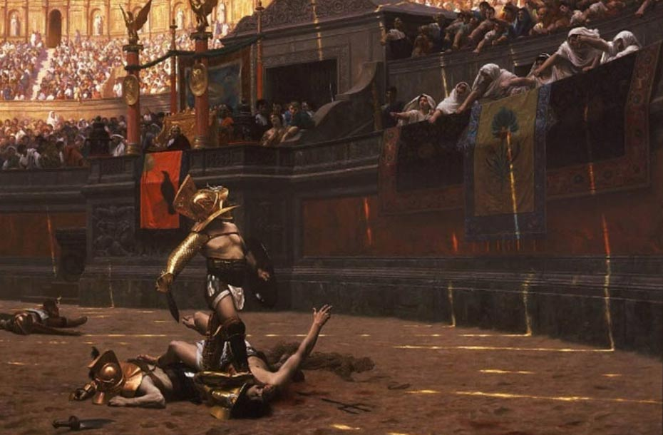
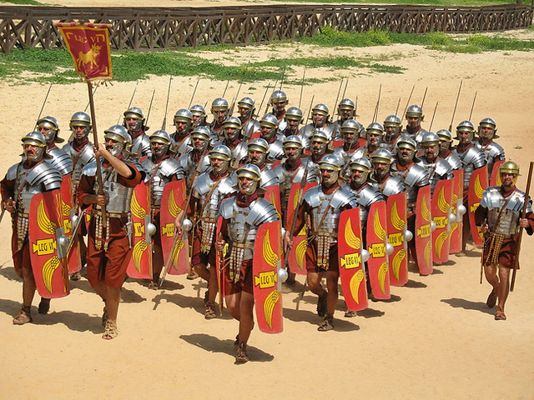
violence

Slide 5
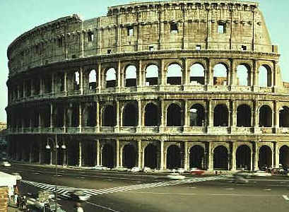
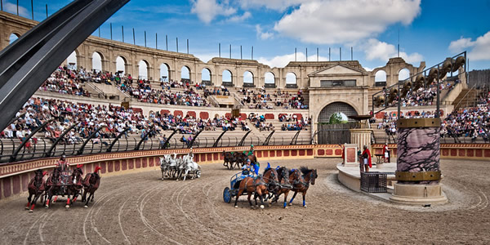
Entertainment-oriented

Slide 6
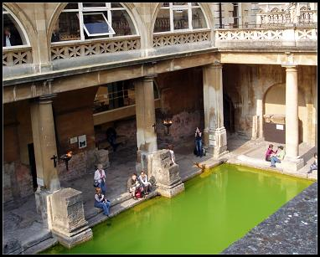

Immorality

Slide 7
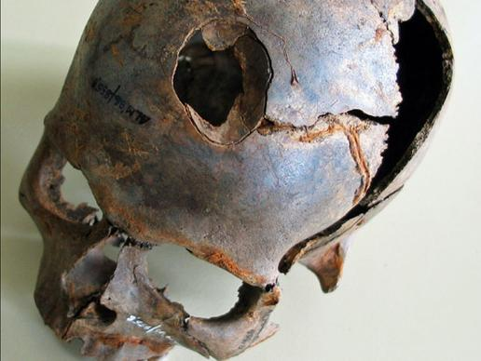
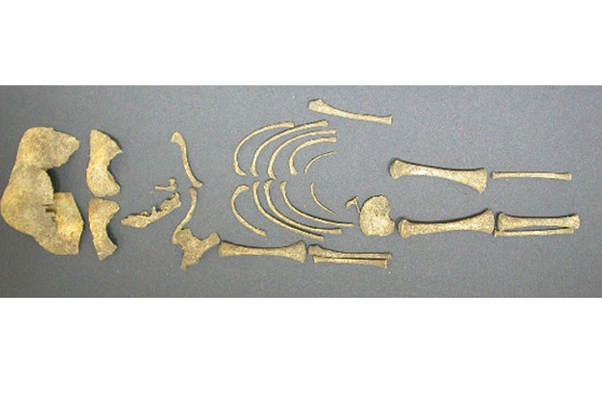
Infanticide

Slide 8
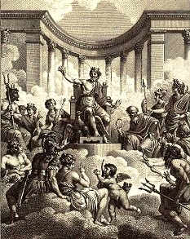
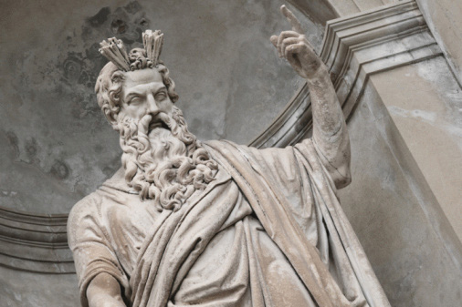
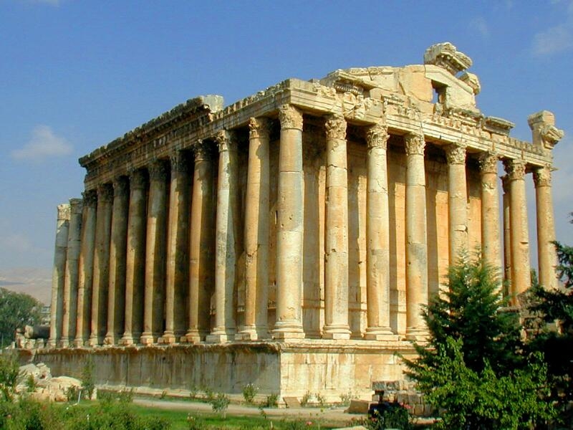
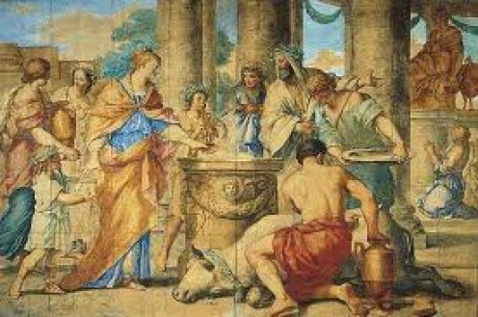
paganism

Slide 9
Counter-Culture in worship
Christians separated themselves from the pervasive polytheism of Roman life.
  Greeks and Romans had a god for every occasion; many social events involved acknowledgement of the appropriate god.
  They would not offer incense to the emperor and pledge their loyalty to him.

Slide 10
Counter-culture in entertainment
Christians shunned Roman entertainment, which was often extremely immoral.
  Gladiatorial combats
  Theater

Slide 11
Counter-culture in Morals
Christians who owned slaves treated them humanely and considered them their equals in the church.
Christians upheld the sanctity of human life, in contrast with pagans, who often committed infanticide.
They practiced chastity and marital fidelity.

